Slide 1


Slide 2
This power point presentation was created by
Mark R. Wright, OD, FCOVD
Copyright 2016 – Progressive Publishing Company – All rights reserved

Slide 3
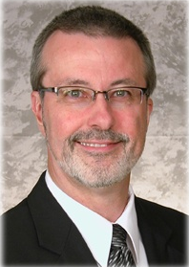
Mark Wright, OD, FCOVD
CEO: Pathways to Success for Optometrists
  mwright@pathways-o.com
Editor: Review of Optometric Business
  reviewob.com
CEO: Practice Management Center
  thepmc.net optometrymatch.com
Board: Association of Practice Management Educators
  optometrybusiness.com
Director of the OSU College of Optometry Business Management Program
Author: Coding, Reimbursement and Contracting for Optometry
1980 – 2007 founder and senior partner Professional VisionCare, Westerville, Ohio
Notes:
3
3
Dr. Wright is a 1980 graduate of The Ohio State University College of Optometry, where he is clinical assistant professor and faculty coordinator of OSU’s Business Management Program. Retired from practice last year, Dr. Wright is president of Pathways to Success, Eyecare Business Training and Progressive Publishing Company. All three of these companies are dedicated to the special practice management needs of eyecare practices. Dr. Wright has lectured extensively throughout the U.S. and abroad. His topics include not only practice management, but also managed care, sports vision and vision and traumatic brain injuries. He is also the practice management editor for the Journal of Optometric Vision Development. This is Mark’s first presentation to the MBA. Please welcome Mark Wright…

Slide 4
SPEAKER FINANCIAL DISCLOSURE STATEMENT
Mark R. Wright, OD, FCOVD has been a paid speaker for the following companies:
  Alcon
  B&L
  ESSILOR
  Jobson
  Vistakon
  VSP
He is an officer of:
  Pathways to Success
  Practice Management Center
  Association of Practice Management Educators
  Progressive Publishing Company
He is the professional editor of:
  Review of Optometric Business
Diversified Ophthalmics
Eye Recommend
IDOC
IVA
PECAA
PERC
Vision Source

Slide 5
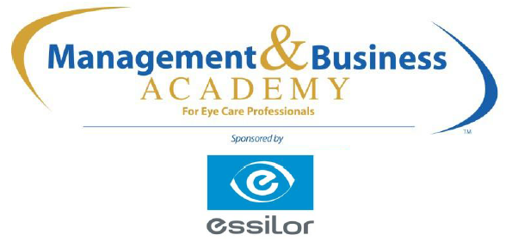
8:30
10:30
11:30
12:30
2:30
4:30
2016

Slide 6

S

Slide 7
Action Plan
What | Who | Success | Date | Resources | Obstacles

Slide 8



What is the MBA program
New
&
Established
Notes:
Gathering data from optometric practices since 2005
The largest database of its kind
Includes practices across the entire spectrum of size & characteristics
New and Established practices

Slide 9


Slide 10
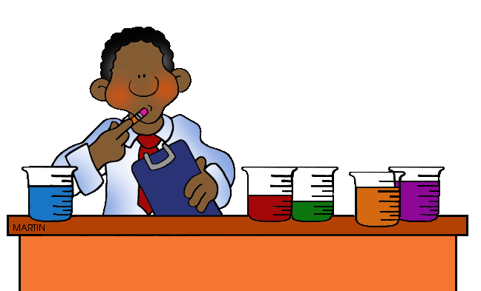
Revenue mix
Staffing philosophy?
How do you define success?
Age of your practice
Size of your practice
VARIABLES

Slide 11
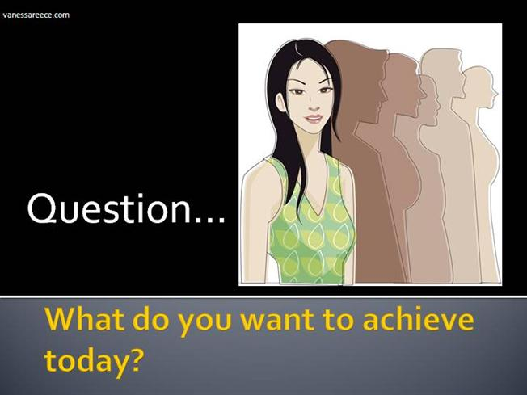

Slide 12
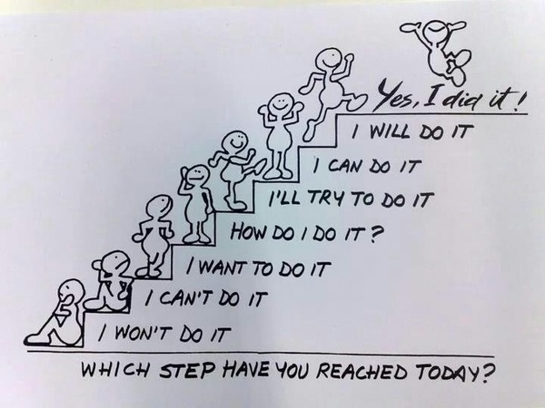
WHICH STEP DO YOU WANT TO REACH TODAY?

Slide 13

Size of the practice
1 OD: <$500K $550K-$749K >$750K
2 OD or +: <$750K $750K-$1.49M >$1.5M 1 location
2 OD or +: <$1M $1M-$1.49M >$1.5M 2 or + locations

Slide 14
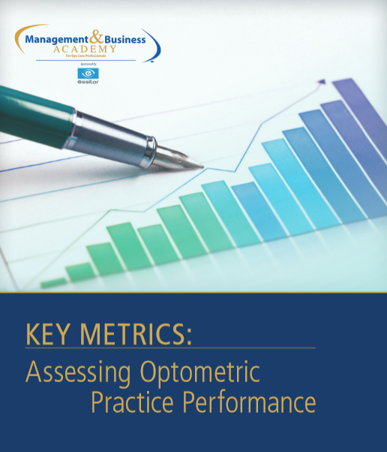
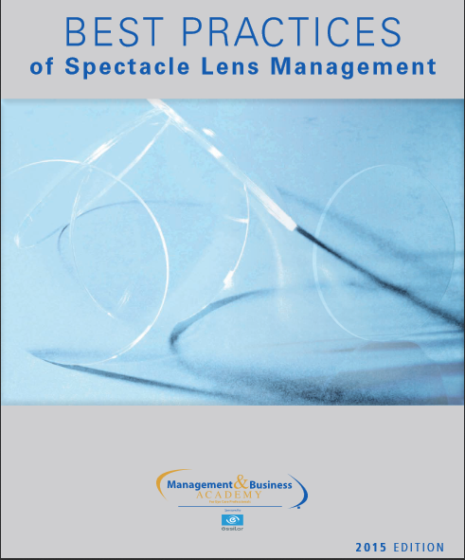
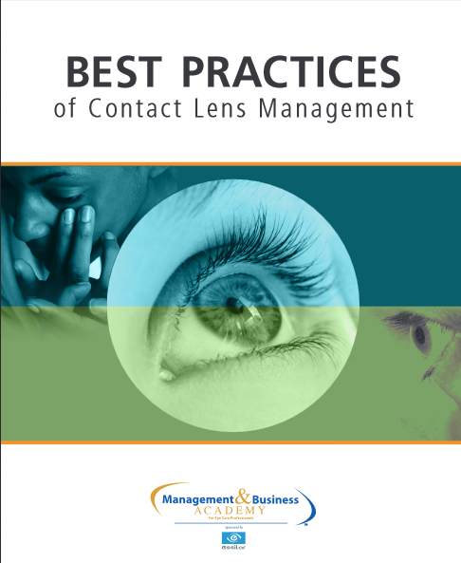
A walk through your Practice Profile Report
1) Compare your results to Benchmarks
2) Discuss levers to improve the numbers
3) Create an ACTION PLAN
Practice
Profile
Report

Slide 15
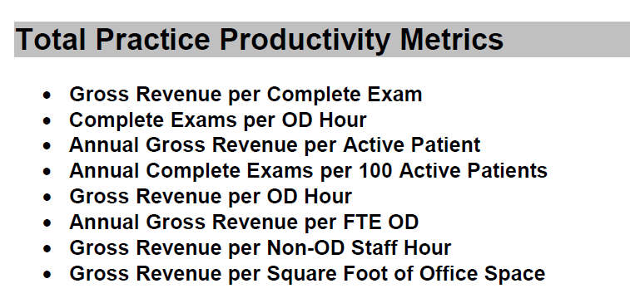

Slide 16
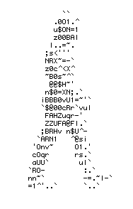
What is the measurable end product of the practice?

Slide 17
What do we want to produce at the end of every visit?
A loyal, educated, patient with a healthy, functional visual system who completes the treatment plan, completes the exchange, returns for ongoing care, and refers other people for care.

Slide 18
Money IN
Money OUT
Money LEFT OVER

Slide 19
Total Gross Collections
Total Expenses
Net

Slide 20
Money IN
Money OUT
Money LEFT OVER

Slide 21
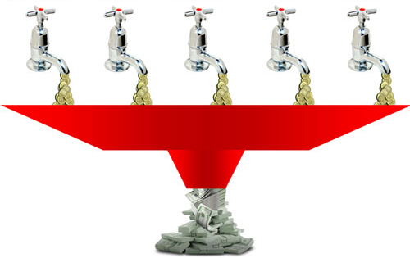

Self
Pay
3rd
Party
Clinic
Optical
CLs
Revenue Streams
Revenue streams refer specifically to the individual methods by which money comes into a company

Slide 22
Create Profit Centers
CLINIC
Revenue
Expenses
Net
EYEWEAR
Revenue
Expenses
Net
CLs
Revenue
Expenses
Net
38% 44% 16%
-
-
-

Slide 23
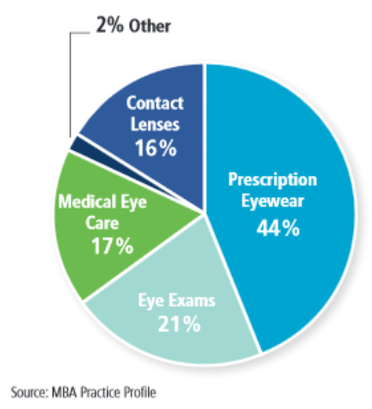


Slide 24
Direct your accountant to arrange the chart of accounts in your practice P&L
Income/Revenue/Collections
  (38%) Clinic
    (21%) Vision eye exams
    (17%) Medical eye care
  (44%) Eyeglasses
  (16%) Contact Lenses
  (2%) Other
Expenses
  COGS
  Staff Payroll
  Doctor Payroll
  Marketing
  Clinical Equipment
  Occupancy
  Overhead
Net
25%
20%
20%
01%
01%
08%
10%
Optometric Net = True Net + Doctor Payroll
Notes:
24

Slide 25
Increase your top line
# of new patients
Fees
Per patient income
Frequency of visits

Slide 26

A 10% increase in FEES is a 30% increase in NET

Slide 27

What’s your greatest fear if you raise fees?

Slide 28


Slide 29

Manage by numbers, not emotion
10% increase in fees
30% increase in net
3-5% of your patients leave
10% leave
90% stay
You have a 27% increase in net

Slide 30
Increase your top line
# of new patients
Fees
Per patient income
Frequency of visits

Slide 31
Packaging
Capture rate
Bundling
Preset patients
Multiple sales
Write Rx for each Rx
Manage handoff
Add high end frames
Prescribe
Rx annual CL supplies
How to increase your per patient income

Slide 32
Packaging
Capture rate
Bundling
Preset patients
Multiple sales
Write Rx for each Rx
Manage handoff
Add high end frames
Prescribe
Rx annual CL supplies
How to increase your per patient income

Slide 33
Lens packages
Best
Individualized
State of
the Art
Better
Customized
Premium
Good
Standardized
Standard

Slide 34
We prescribe the best
Best
Better
Good

Slide 35

Packages
Packages increase value
Add-ons are viewed as more expensive

Slide 36
Packaging
Capture rate
Bundling
Preset patients
Multiple sales
Write Rx for each Rx
Manage handoff
Add high end frames
Prescribe
Rx annual CL supplies
How to increase your per patient income

Slide 37
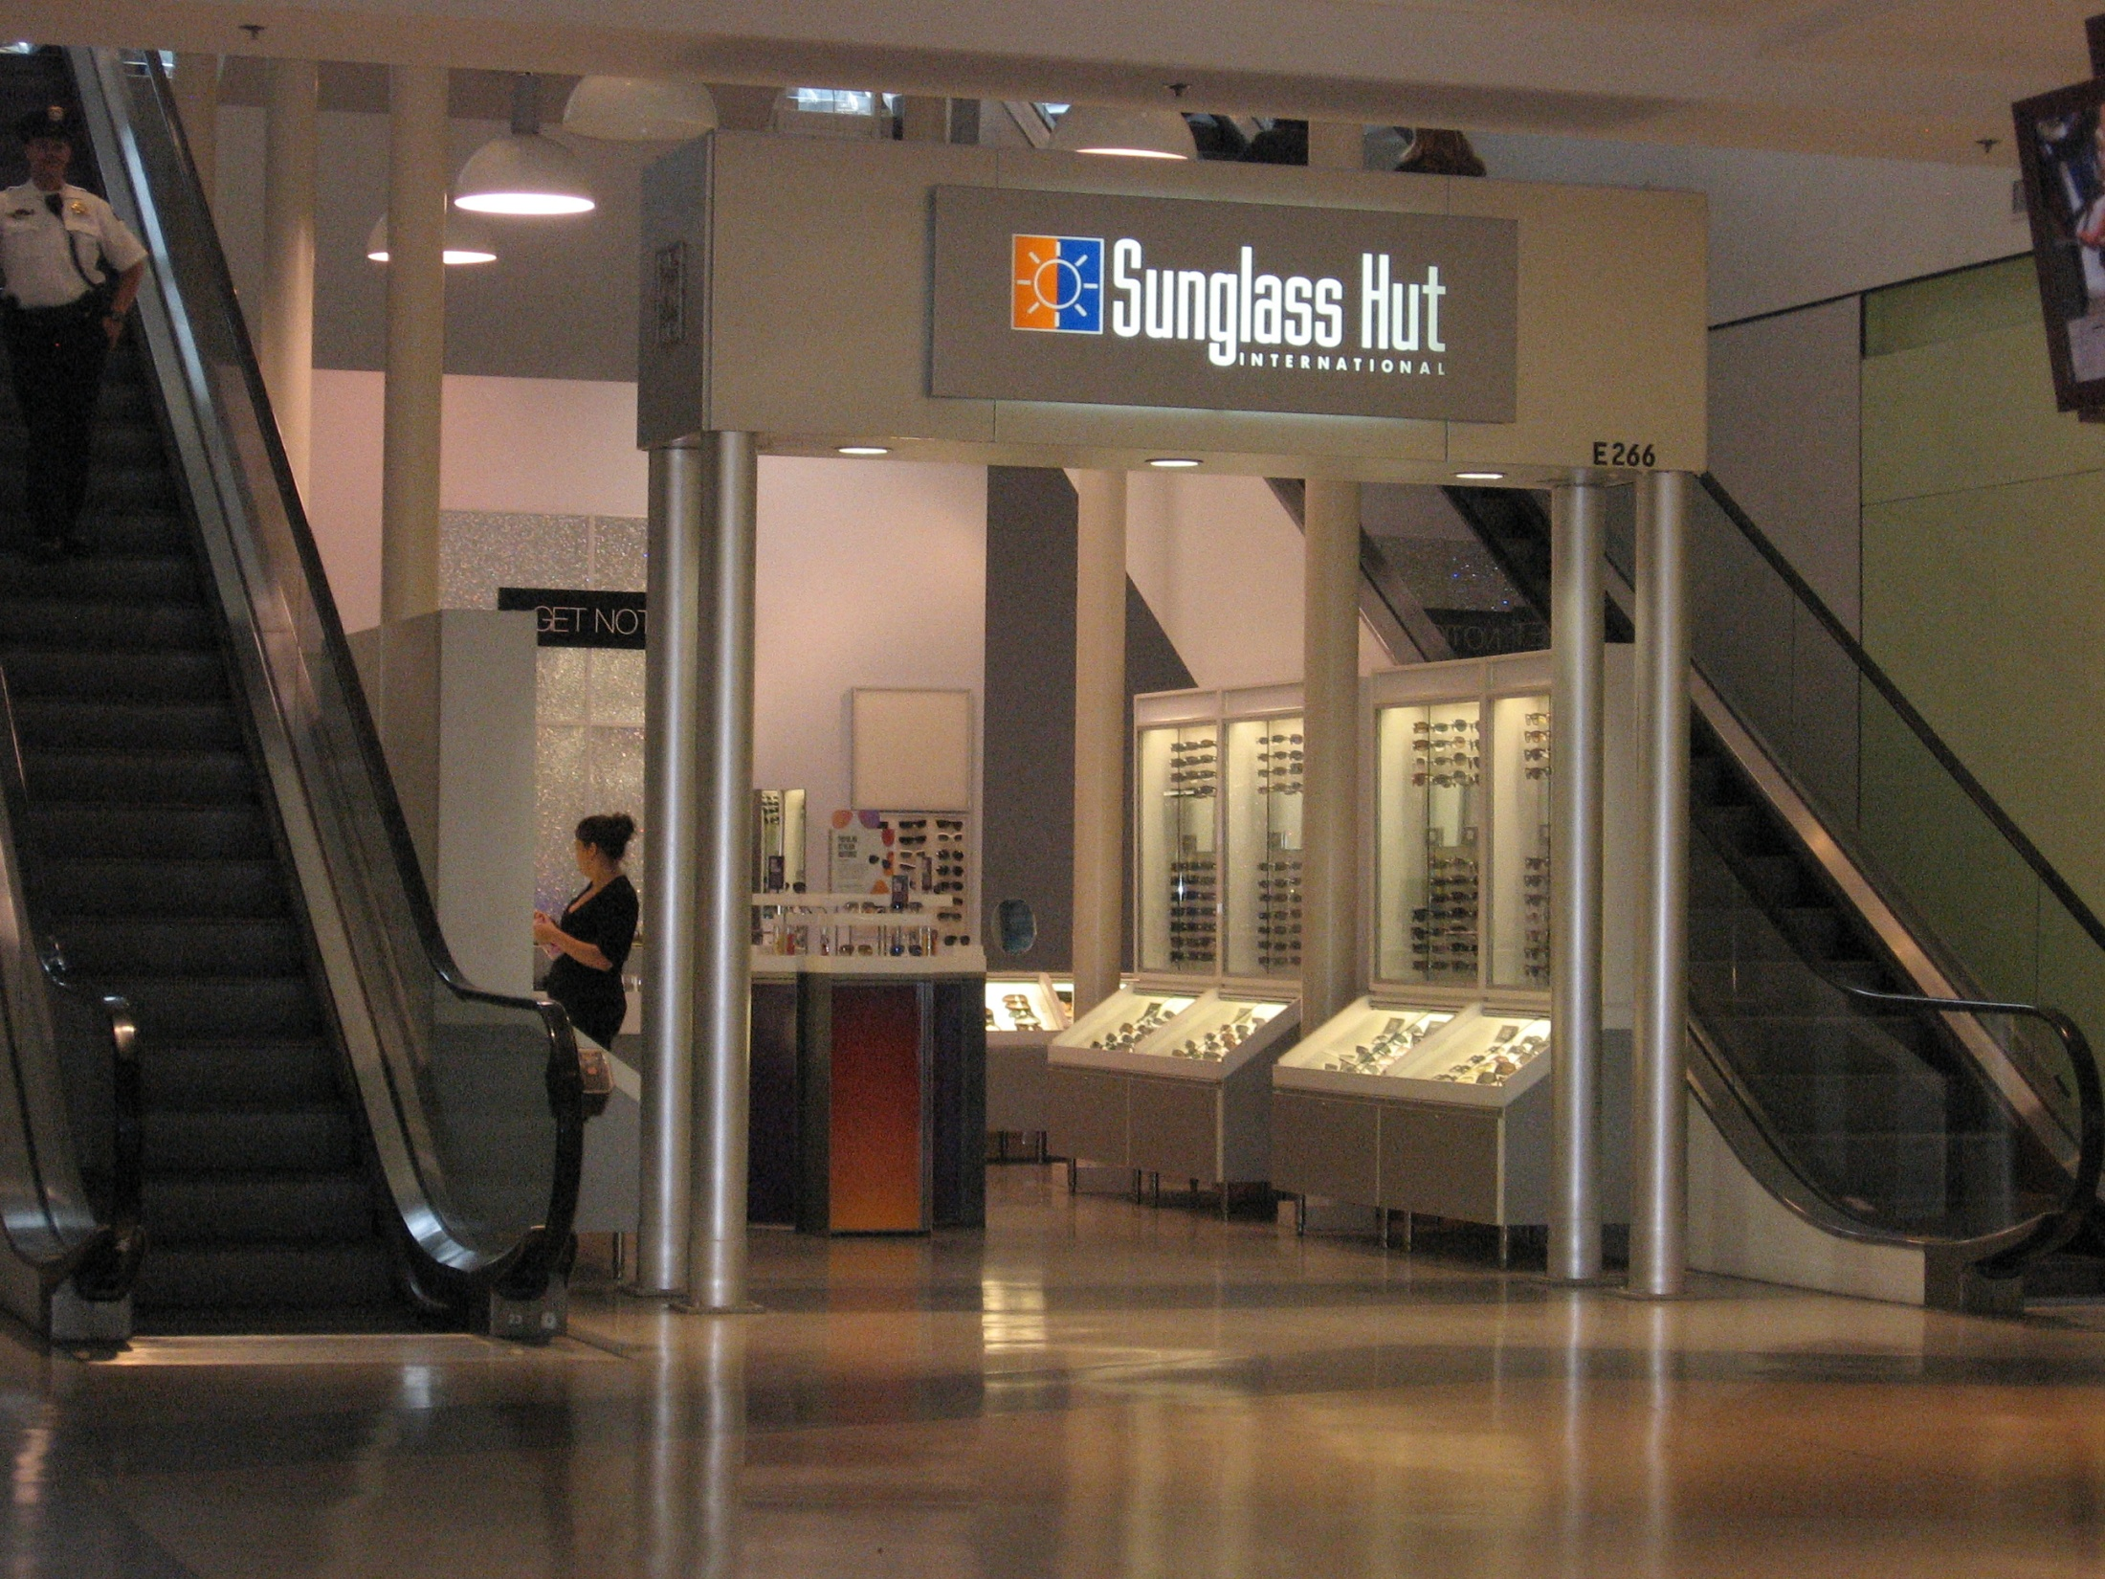

Slide 38
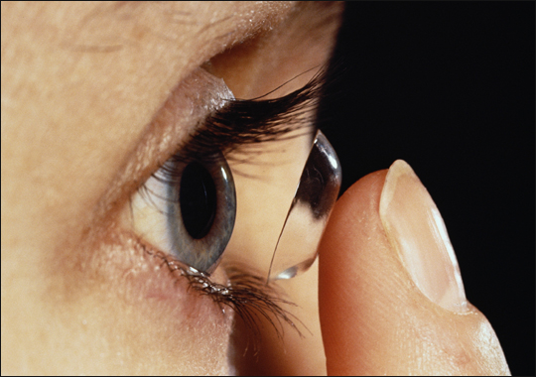

Slide 39

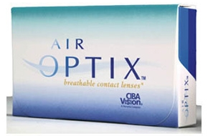
Bundling
Notes:
39

Slide 40
of patients had to ask their doctor for contact lenses
72.5%

Slide 41
Packaging
Capture rate
Bundling
Preset patients
Multiple sales
Write Rx for each Rx
Manage handoff
Add high end frames
Prescribe
Rx annual CL supplies
How to increase your per patient income

Slide 42

Preset patients to purchase
“And don’t forget to bring in your driving sunwear.”

Slide 43
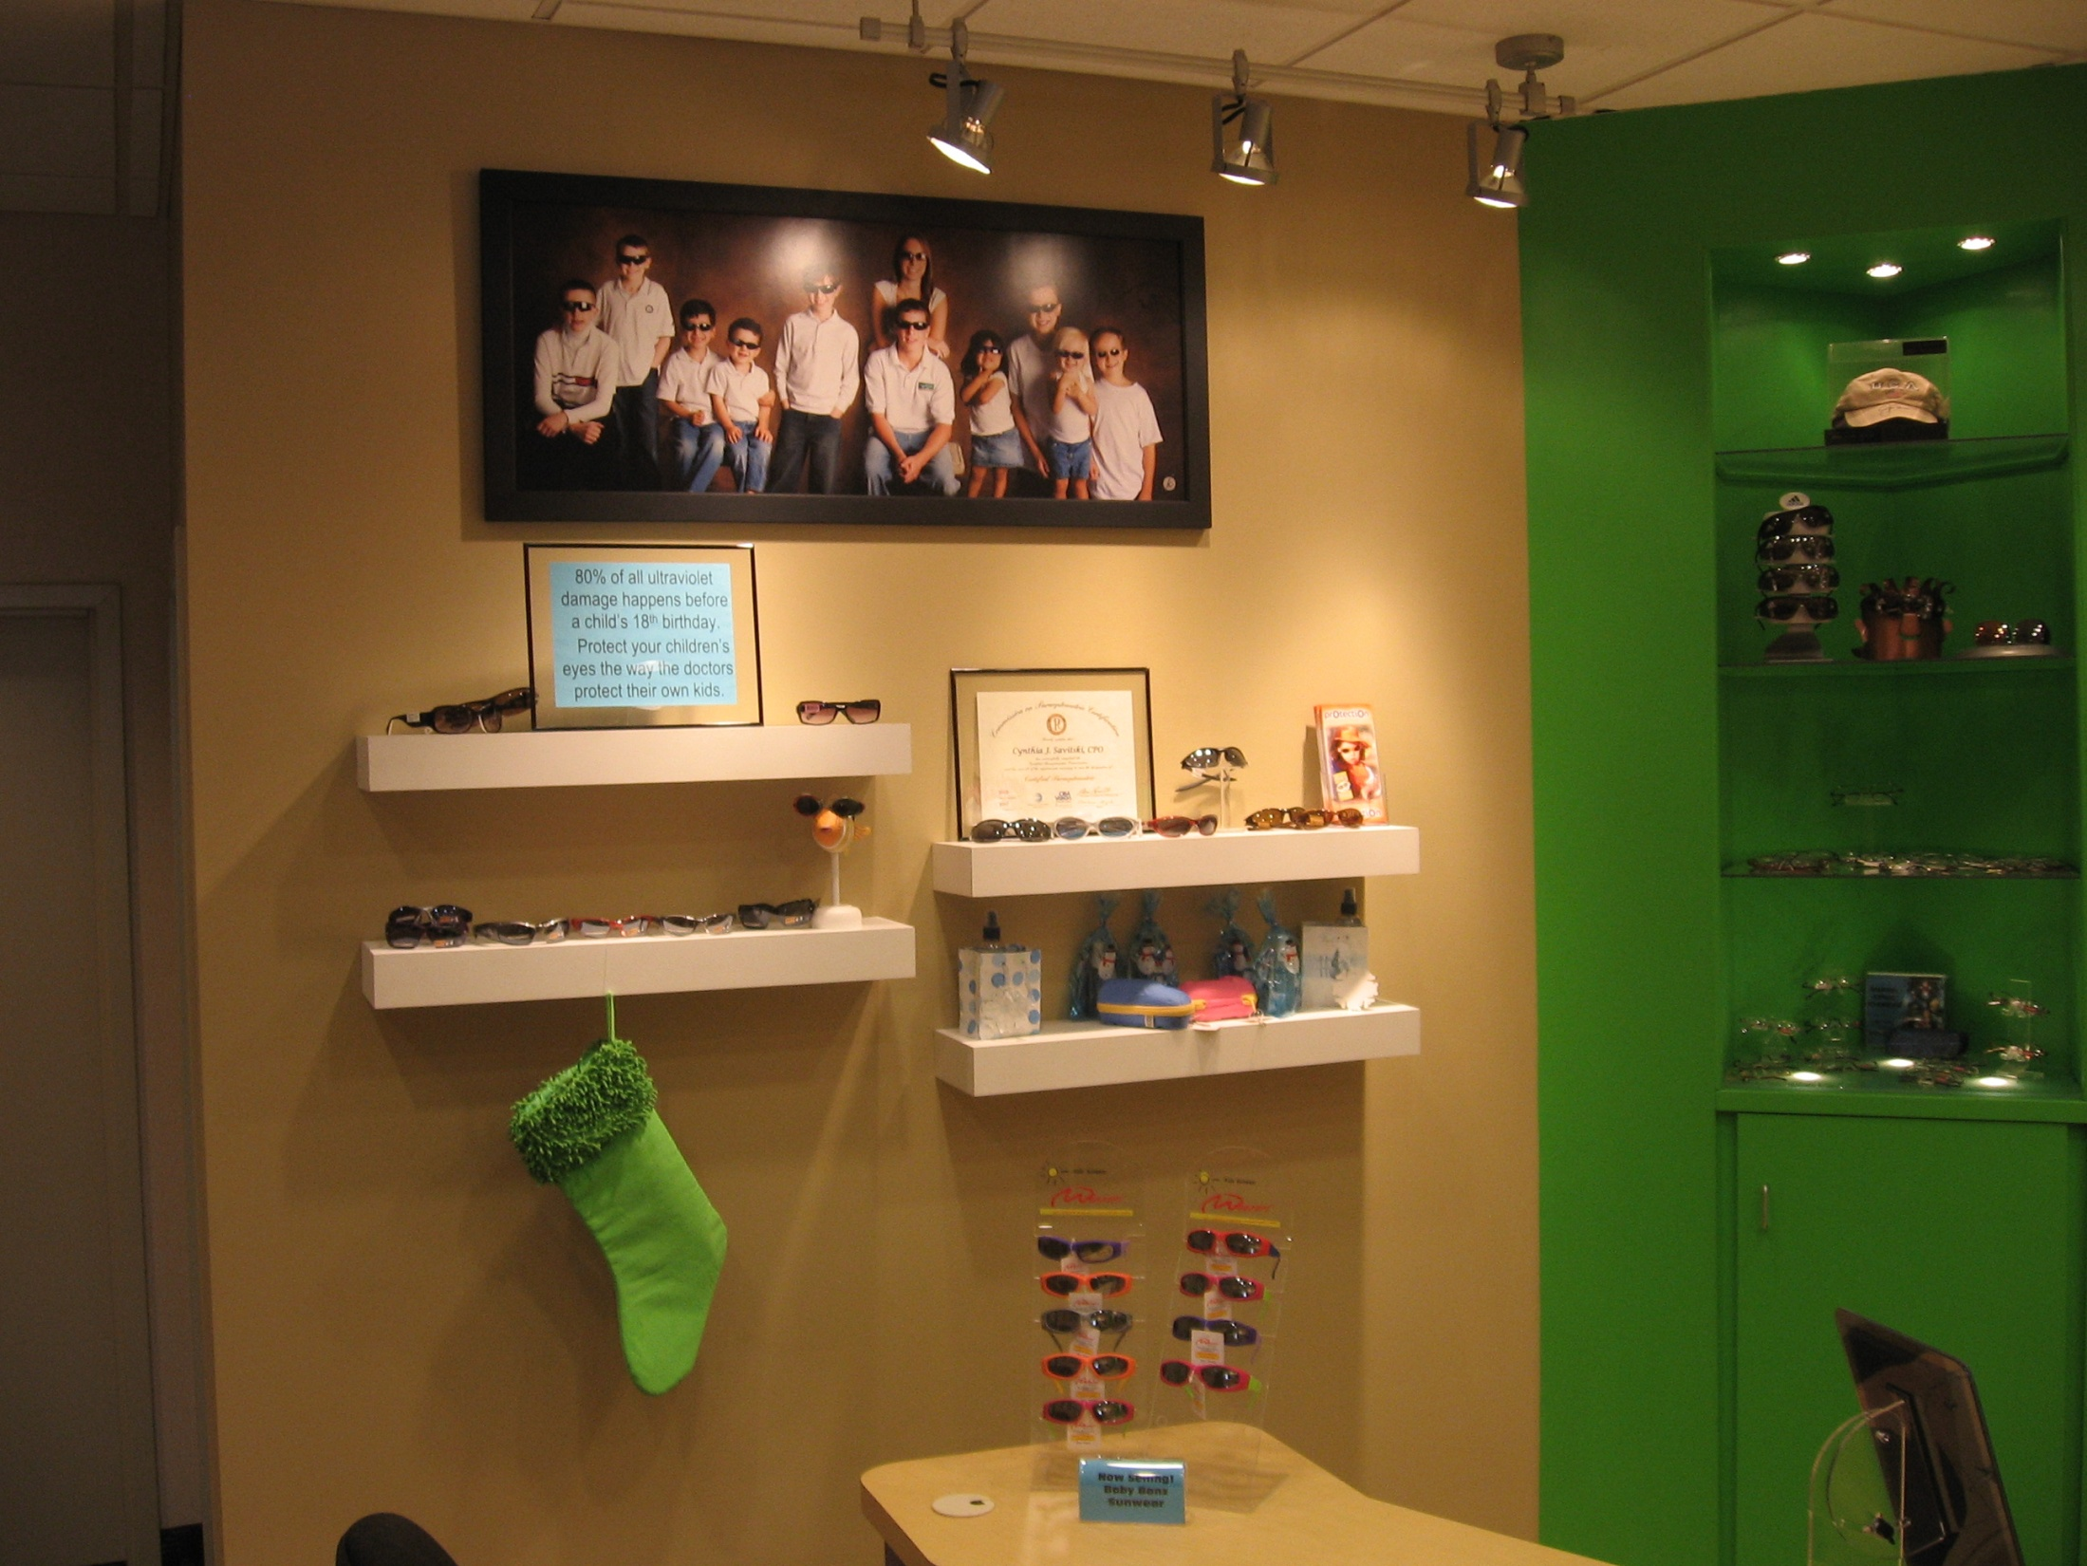
80% of all ultraviolet damage happens before a child’s 18th birthday. Protect your children’s eyes the way the doctors protect their own kids.
43

Slide 44
Packaging
Capture rate
Bundling
Preset patients
Multiple sales
Write Rx for each Rx
Manage handoff
Add high end frames
Prescribe
Rx annual CL supplies
How to increase your per patient income

Slide 45
Adoption Cycle
Awareness
Interest
Internalization
  “It will work for me”
Trial
Repeat purchase
The hardest step

Slide 46
Utilize Success Stories
Tell the story you want told
On the walls
In notebooks in the reception area
On monitors in the office
In patient conversations

Slide 47
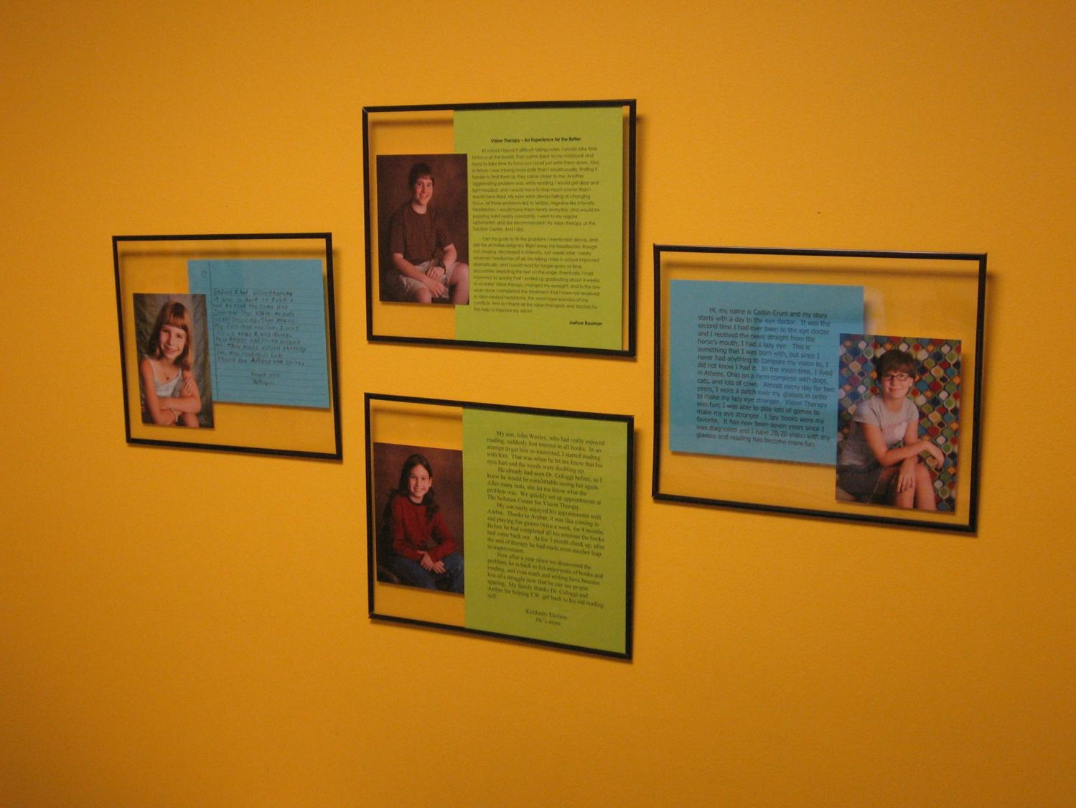

Slide 48

Don’t forget …
Get the HIPAA marketing release form signed

Slide 49
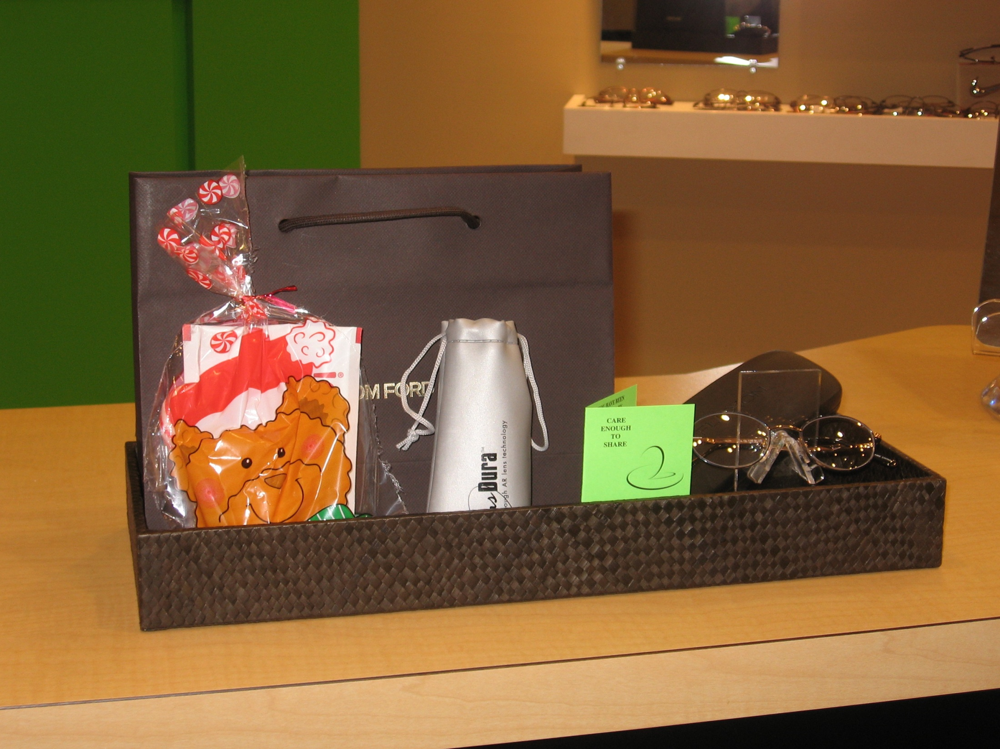
Resell products on dispensing

Slide 50
Packaging
Capture rate
Bundling
Preset patients
Multiple sales
Write Rx for each Rx
Manage handoff
Add high end frames
Prescribe
Rx annual CL supplies
Maximize 3rd Party
Rx Everything
How to increase your per patient income

Slide 51
What are you selling
MATERIAL MIX |  | LENS STYLE
Glass | 1.3% | SV | 51.5%
CR-39 | 46.9% | Multifocal | 20.1%
Polycarbonate | 39.7% | PAL | 28.4%
High index | 12.1%
Trivex | (2%) | LENS TREATMENTS
 |  | AR | 28%
 |  | Transitions | 20%
 |  | Polarized | 8%

Slide 52
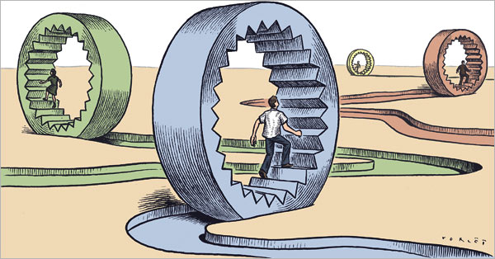

Slide 53
Multiple Pair Sales
Care Credit
% Discount
$ Off
30-50%
vs
$100

Slide 54
Care Credit
Offer it at reception … to everyone

Slide 55
Prescribe everything needed
Priority | Problem | Solution | Time
 | Brightness
 | Blur
 | Headaches
 | Safety risk

Slide 56
Prescribe everything needed
Priority | Problem | Solution | Time
 | Brightness | Sun
 | Blur | Dress
 | Headaches | Computer
 | Safety risk | Sports

Slide 57
Prescribe everything needed
Priority | Problem | Solution | Time
1 | Brightness | Sun
3 | Blur | Dress
4 | Headaches | Computer
2 | Safety risk | Sports

Slide 58
Prescribe everything needed
Priority | Problem | Solution | Time
1 | Brightness | Sun | Today
3 | Blur | Dress | 4 months
4 | Headaches | Computer | 6 months
2 | Safety risk | Sports | 2 months

Slide 59
Packaging
Capture rate
Bundling
Preset patients
Multiple sales
Write Rx for each Rx
Manage handoff
Add high end frames
Prescribe
Rx annual CL supplies
How to increase your per patient income

Slide 60
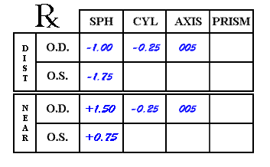
Write an Rx for each prescription
Dress
Computer
Sunglasses

Slide 61
Packaging
Capture rate
Bundling
Preset patients
Multiple sales
Write Rx for each Rx
Manage handoff
Add high end frames
Prescribe
Rx annual CL supplies
How to increase your per patient income

Slide 62
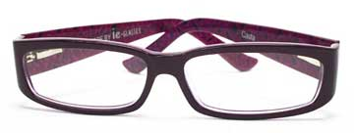
Eyewear Capture Rate
Independent ECPs
  Perform 66% of eye exams
  Sell 41% of eyeglasses

Slide 63
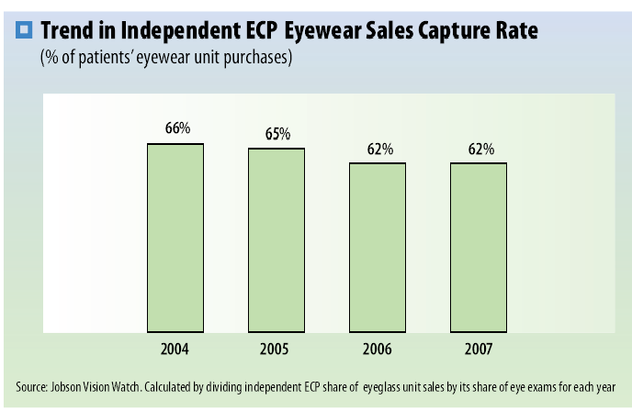
Eyewear Capture Rate
60%
2016

Slide 64
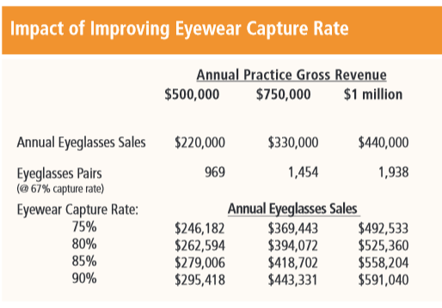
$75,418 $113,331 $151,040

Slide 65
How do you improve your capture rate?
Measure to manage
Things get better when you measure

Slide 66
Packaging
Capture rate
Bundling
Preset patients
Multiple sales
Write Rx for each Rx
Manage handoff
Add high end frames
Prescribe
Rx annual CL supplies
How to increase your per patient income

Slide 67

Levels of handoff
Optician entire time
Optician before case presentation
Optician after case presentation
Dispensary handoff
Dispensary file holder

Slide 68
Packaging
Capture rate
Bundling
Preset patients
Multiple sales
Write Rx for each Rx
Manage handoff
Add high end frames
Prescribe
Rx annual CL supplies
How to increase your per patient income

Slide 69
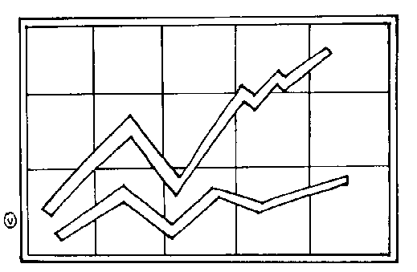
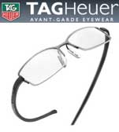
Consider adding high end frames

Slide 70
Packaging
Capture rate
Bundling
Preset patients
Multiple sales
Write Rx for each Rx
Manage handoff
Add high end frames
Prescribe
Rx annual CL supplies
How to increase your per patient income

Slide 71

Doctor Power

Slide 72

Dr must prescribe in the exam room

Slide 73
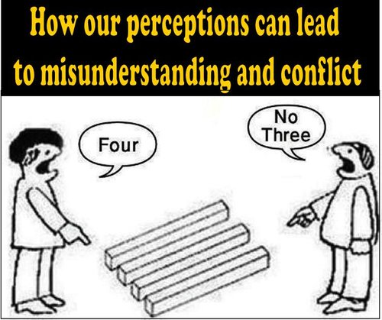

Slide 74
“My glasses have my doctor’s Rx, therefore, it really doesn’t matter where I buy them - they will still have my doctor’s prescription in them.”

Slide 75
The Misunderstanding
That You MUST Address
Because my glasses have my eye doctor’s prescription in them, it doesn’t matter where I buy them
Prescription
Lens Design
Manufacturing Process

Slide 76
Packaging
Capture rate
Bundling
Preset patients
Multiple sales
Write Rx for each Rx
Manage handoff
Add high end frames
Prescribe
Rx annual CL supplies
How to increase your per patient income

Slide 77

CL Pricing
Lost Leader
Specialist

Slide 78
Prescribe a year’s supply of CLs
Dr: “I’m prescribing a year’s supply of CLs for you.”
Staff: “I see the doctor prescribed a year’s supply of CLs for you.”
Compliance

Slide 79

Annual Sales vs Boxes

Slide 80

Do you offer CLs to everybody?

Slide 81
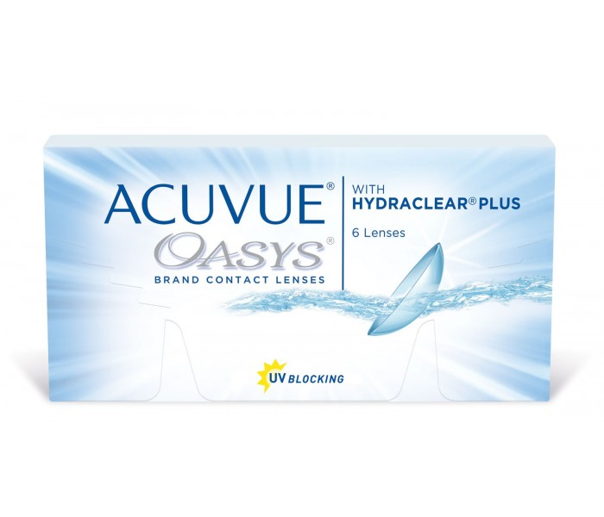
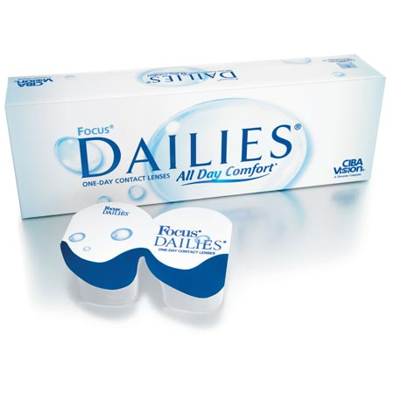
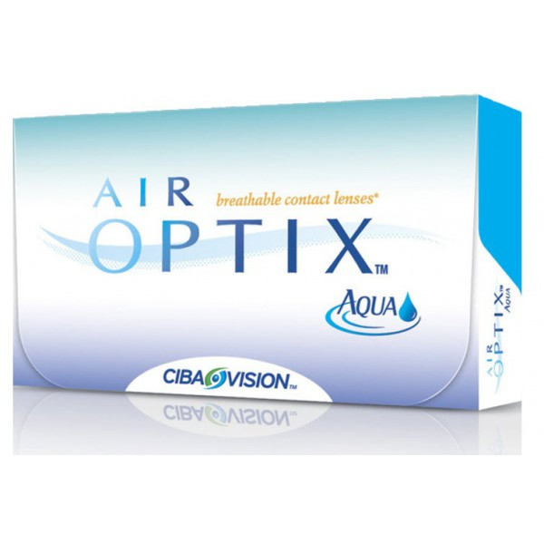
CLs + CLs
+

Slide 82
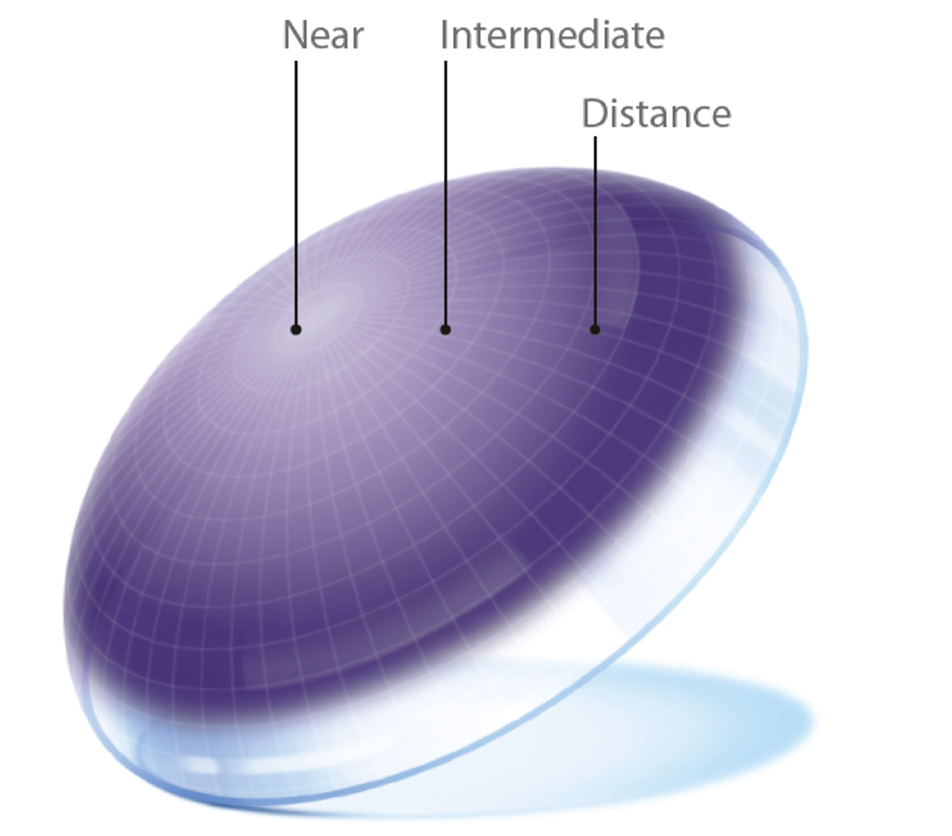
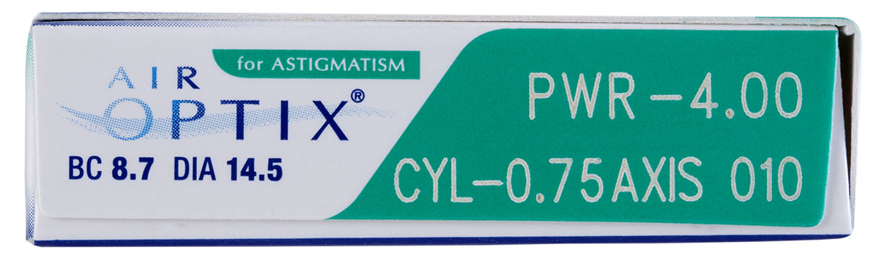
Specialty Lenses

Slide 83
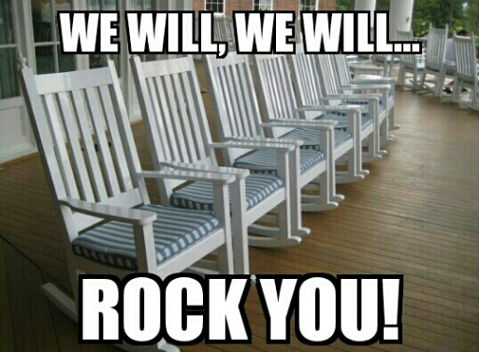
What % of people 40+ yo that require mulifocal lenses express interest in wearing CLs? About 50%

Slide 84
91 patients
Offered CLs before Optical
Straight to Optical
88% agreed to try CLs
Atkins NP, et al. Enhancing the approach to selecting eyewear (EASE): A multi-centre, practice-based study into the effect of applying contact lenses prior to spectacle dispensing. Contact Lens & Anterior Eye (2009), doi:10.1016.
EASE Study
Enhancing the Approach to Selecting Eyewear
These patients reported “a superior subjective spectacle dispensing experience”
Spent 32 % more on their spectacles than the other group
33 % purchased contact lenses, compared with 13 percent of the other group

Slide 85
Where is the best place for the patient to receive their annual supply of contact lenses?

Slide 86

At work!

Slide 87
Increase your top line
# of new patients
Fees
Per patient income
Frequency of visits

Slide 88

CL
18 months
Eyewear
28 months

Slide 89
Pre-appoint
CL
18 months
Eyewear
28 months
15 months
15 months

Slide 90
2 Months Sooner
12.5% increase

Slide 91
4 Months Sooner
25% increase

Slide 92
Increase your top line
# of new patients
Fees
Per patient income
Frequency of visits

Slide 93

New patients
Established patients

Slide 94

New patients
Established patients

Slide 95


Every year, 5-10% of your patients

Slide 96
So, if you want 10% practice growth
10% replacement
10% growth
20% new patients for 10% growth

Slide 97

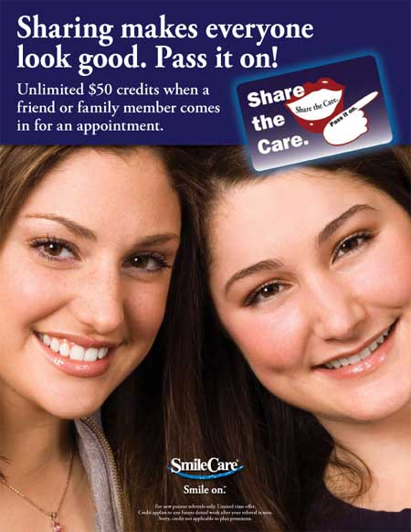


Reward Current Patients for Sending New Patients
Share
the
Care
Share the care
Notes:
97

Slide 98
Increase the # of new patients
Target alpha dogs (connectors)
Ask for family members
Trunk shows
Current patients recruit new patients
In-office seminars
Notes:
98

Slide 99
Create in-office seminars
You are invited to a discussion about
Wednesday evening
8-3-2016
from 6-8 pm
Please feel free to
bring a friend
Night driving
solutions
9-27-2017

Slide 100
Money IN
Money OUT
Money LEFT OVER

Slide 101
Expenses
COGS
Staff Payroll
Overhead
Marketing
Clinical Equipment
Occupancy
Gross - = Optometric Net
Notes:
101

Slide 102
Expenses
COGS
Staff Payroll
Overhead
Marketing
Clinical Equipment
Occupancy
Gross - = Optometric Net
100%
30%
70%
Notes:
102

Slide 103
Expenses
COGS
Staff Payroll
Overhead
Marketing
Clinical Equipment
Occupancy
Gross - = Optometric Net
100%
40%
60%
Notes:
103

Slide 104
Expenses
COGS
Staff Payroll
Overhead
Marketing
Clinical Equipment
Occupancy
Gross - = Optometric Net
100%
35%
65%
Notes:
104

Slide 105
1 FTE OD, 1 location | Benchmarks
INCOME
Gross Revenue | $700,000
EXPENSES
COGS | $175,000 | 25.0%
Staff Payroll | $140,000 | 20.0%
Doctor Payroll | $140,000 | 20.0%
Marketing | $7,000 | 1.0%
Clinical Equipment | $7,000 | 1.0%
Occupancy | $56,000 | 8.0%
Overhead | $70,000 | 10.0%
TOTAL EXPENSES | $595,000 | 85.0%
NET | $105,000 | 15.0%
OPTOMETRIC NET | $245,000 | 35.0%

Slide 106
Cost of Goods Sold
27-33% of Gross Collections, Ave = 29%
Lab bills
  Frames
  Lenses
  Contact lenses
  Cases
  Solutions
  If it comes from a lab and you are selling it
If you have an in-house lab, treat it as a separate company and charge it as a lab expense
  Assign % of staff payroll
  Assign % of rent
  Charge any lease or loan payments
Notes:
106

Slide 107
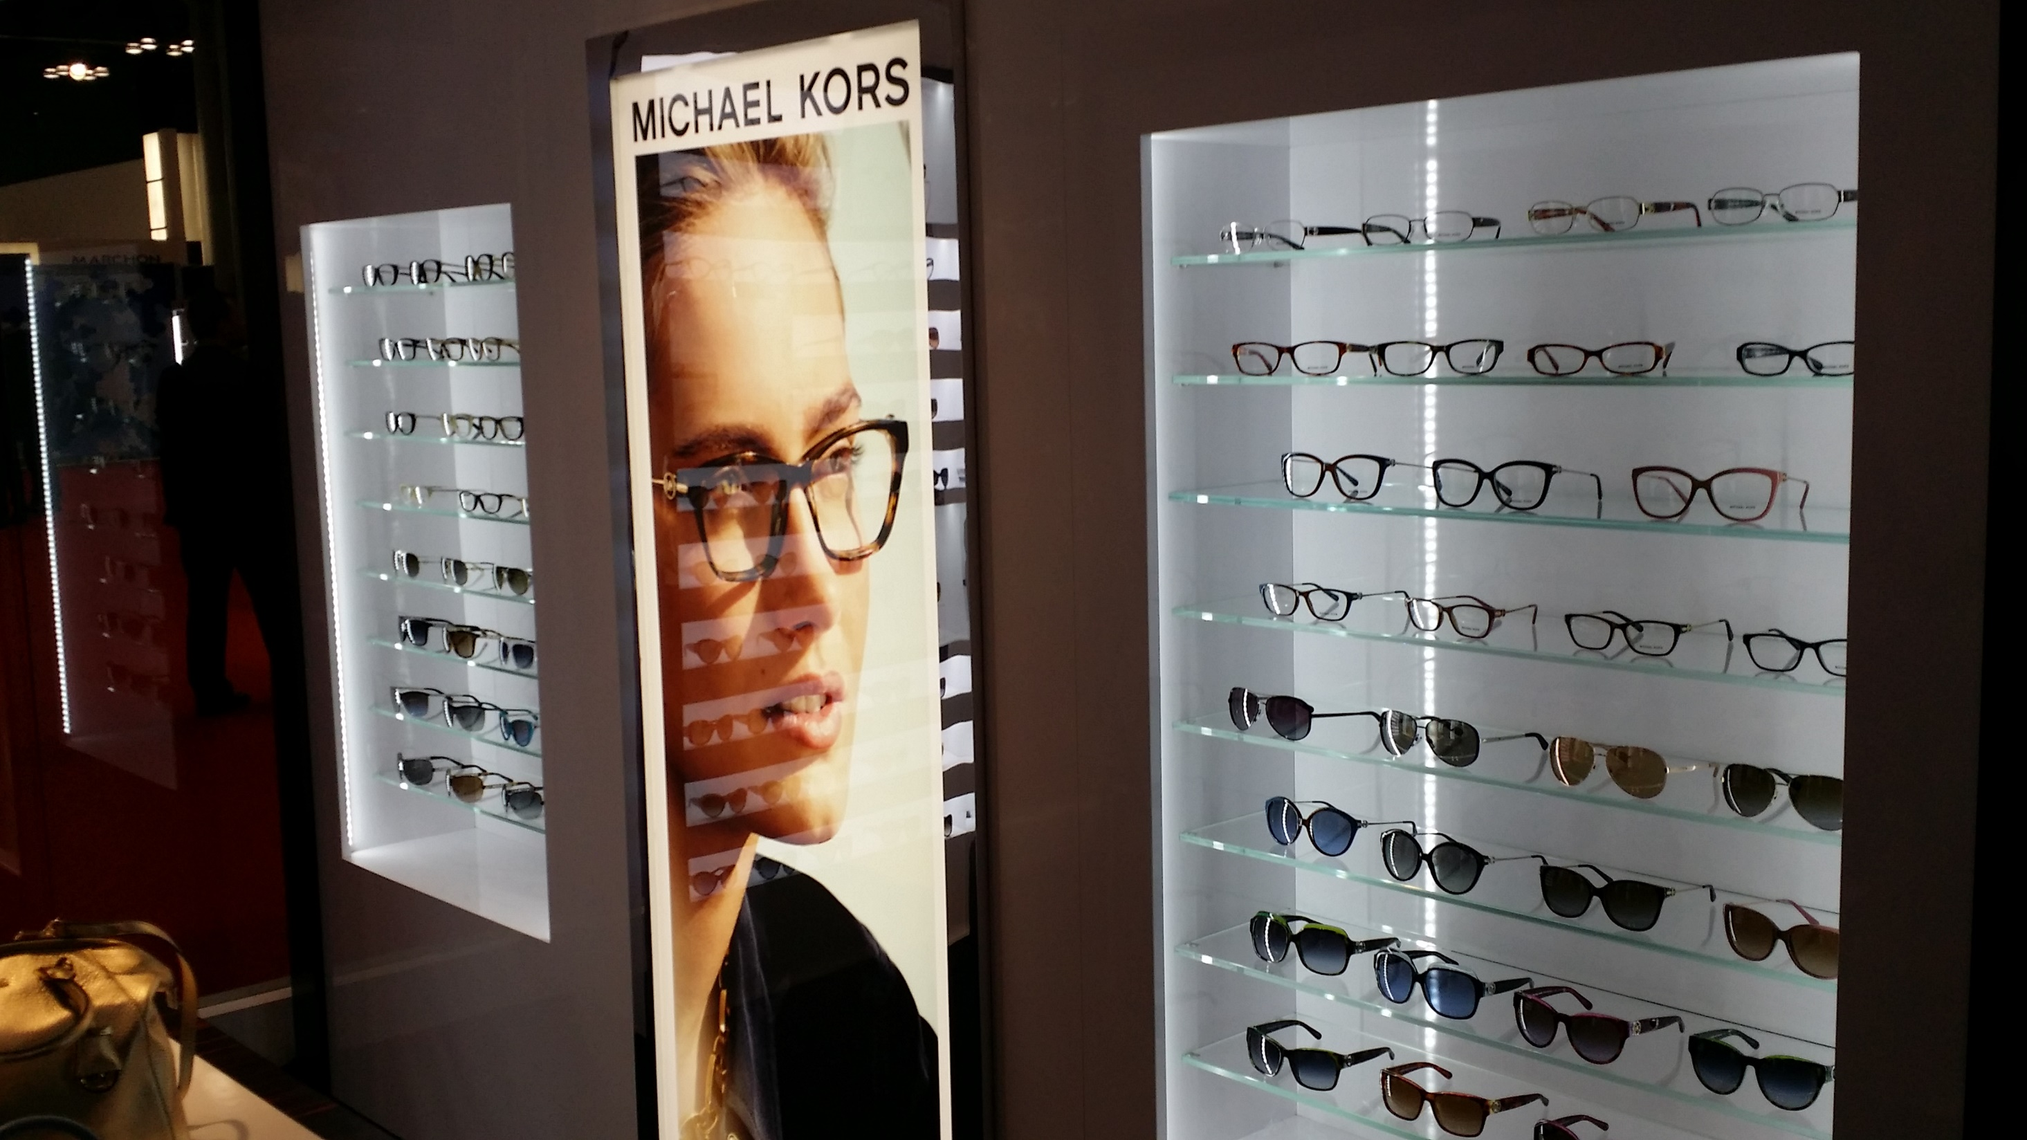

Slide 108
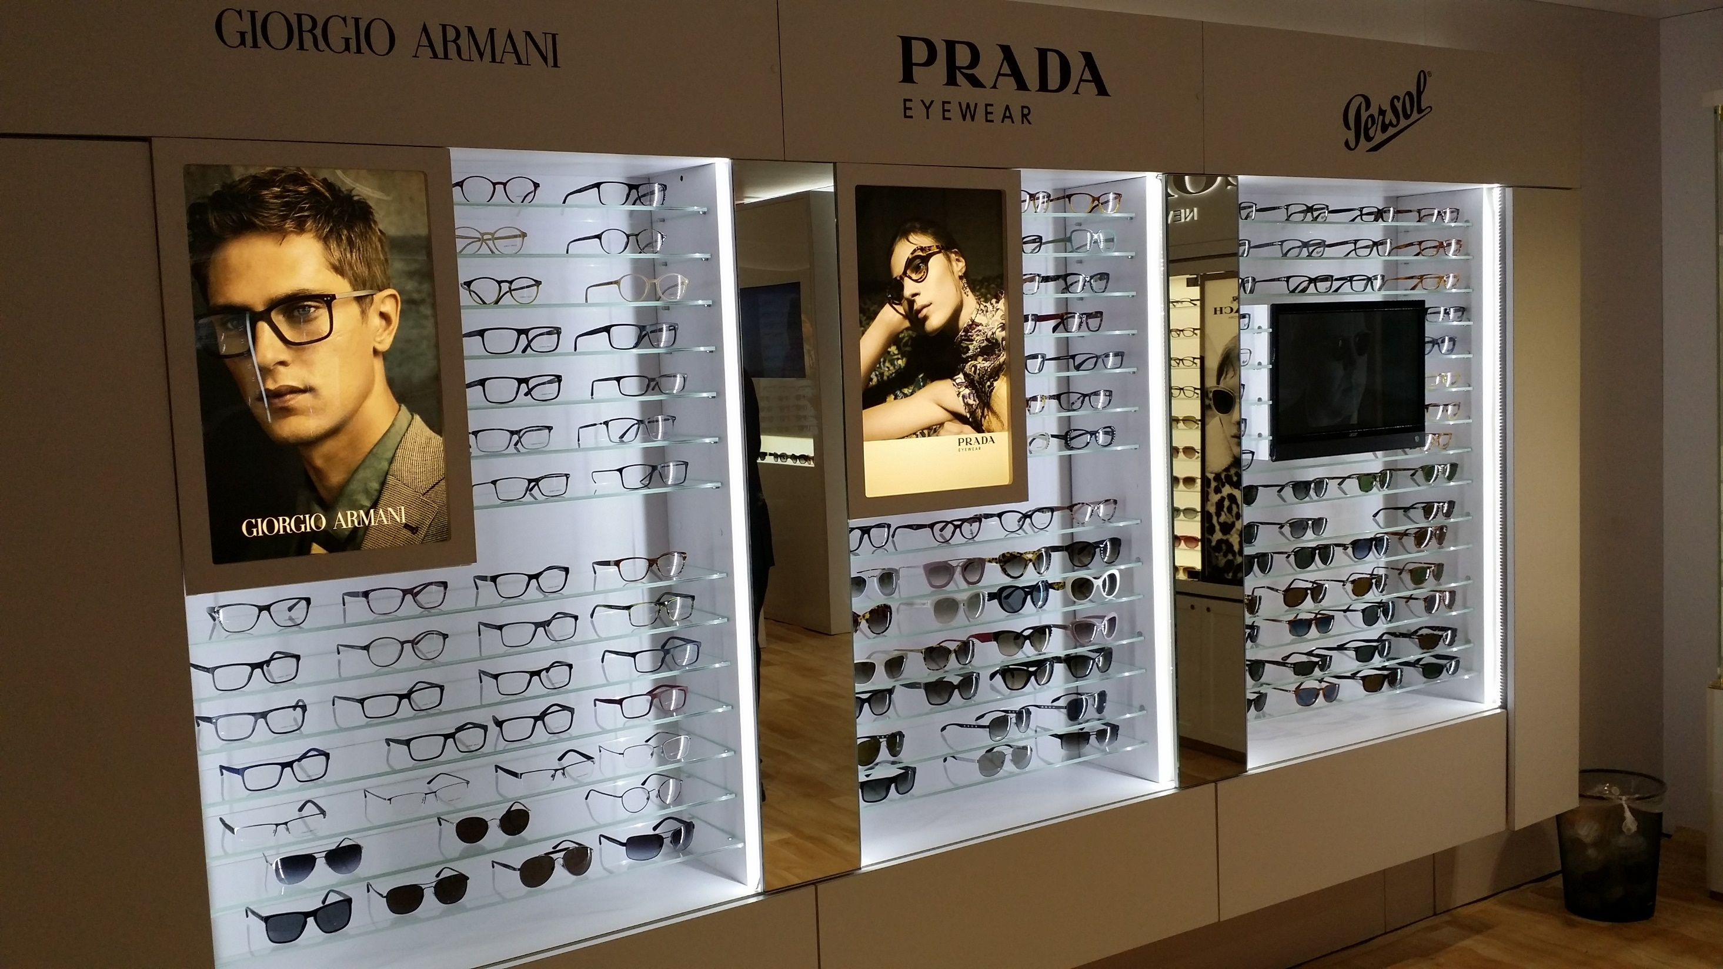

Slide 109
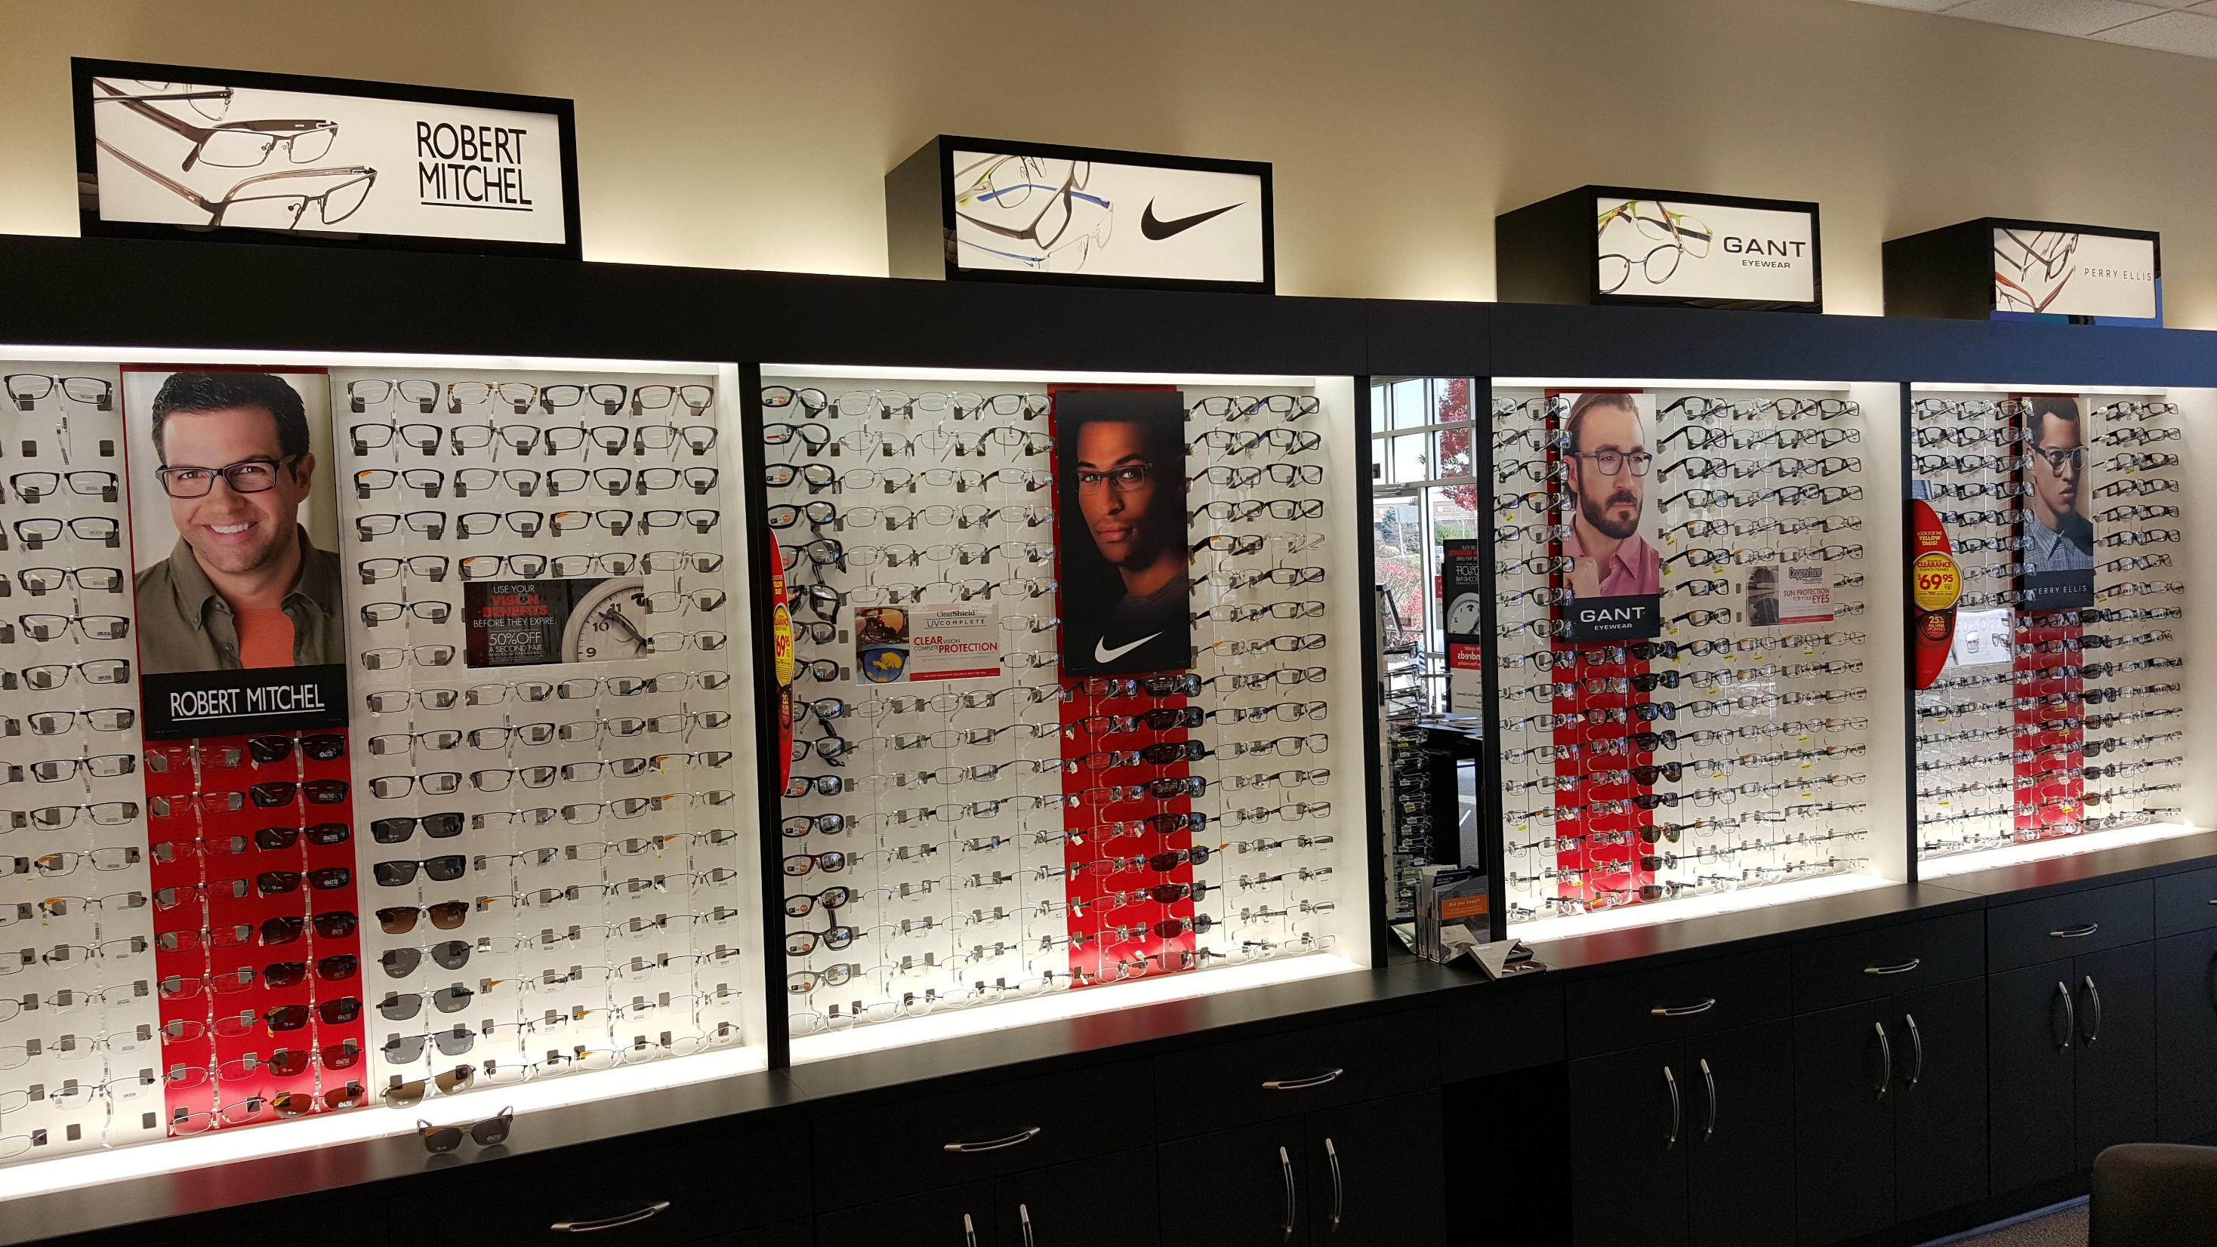

Slide 110
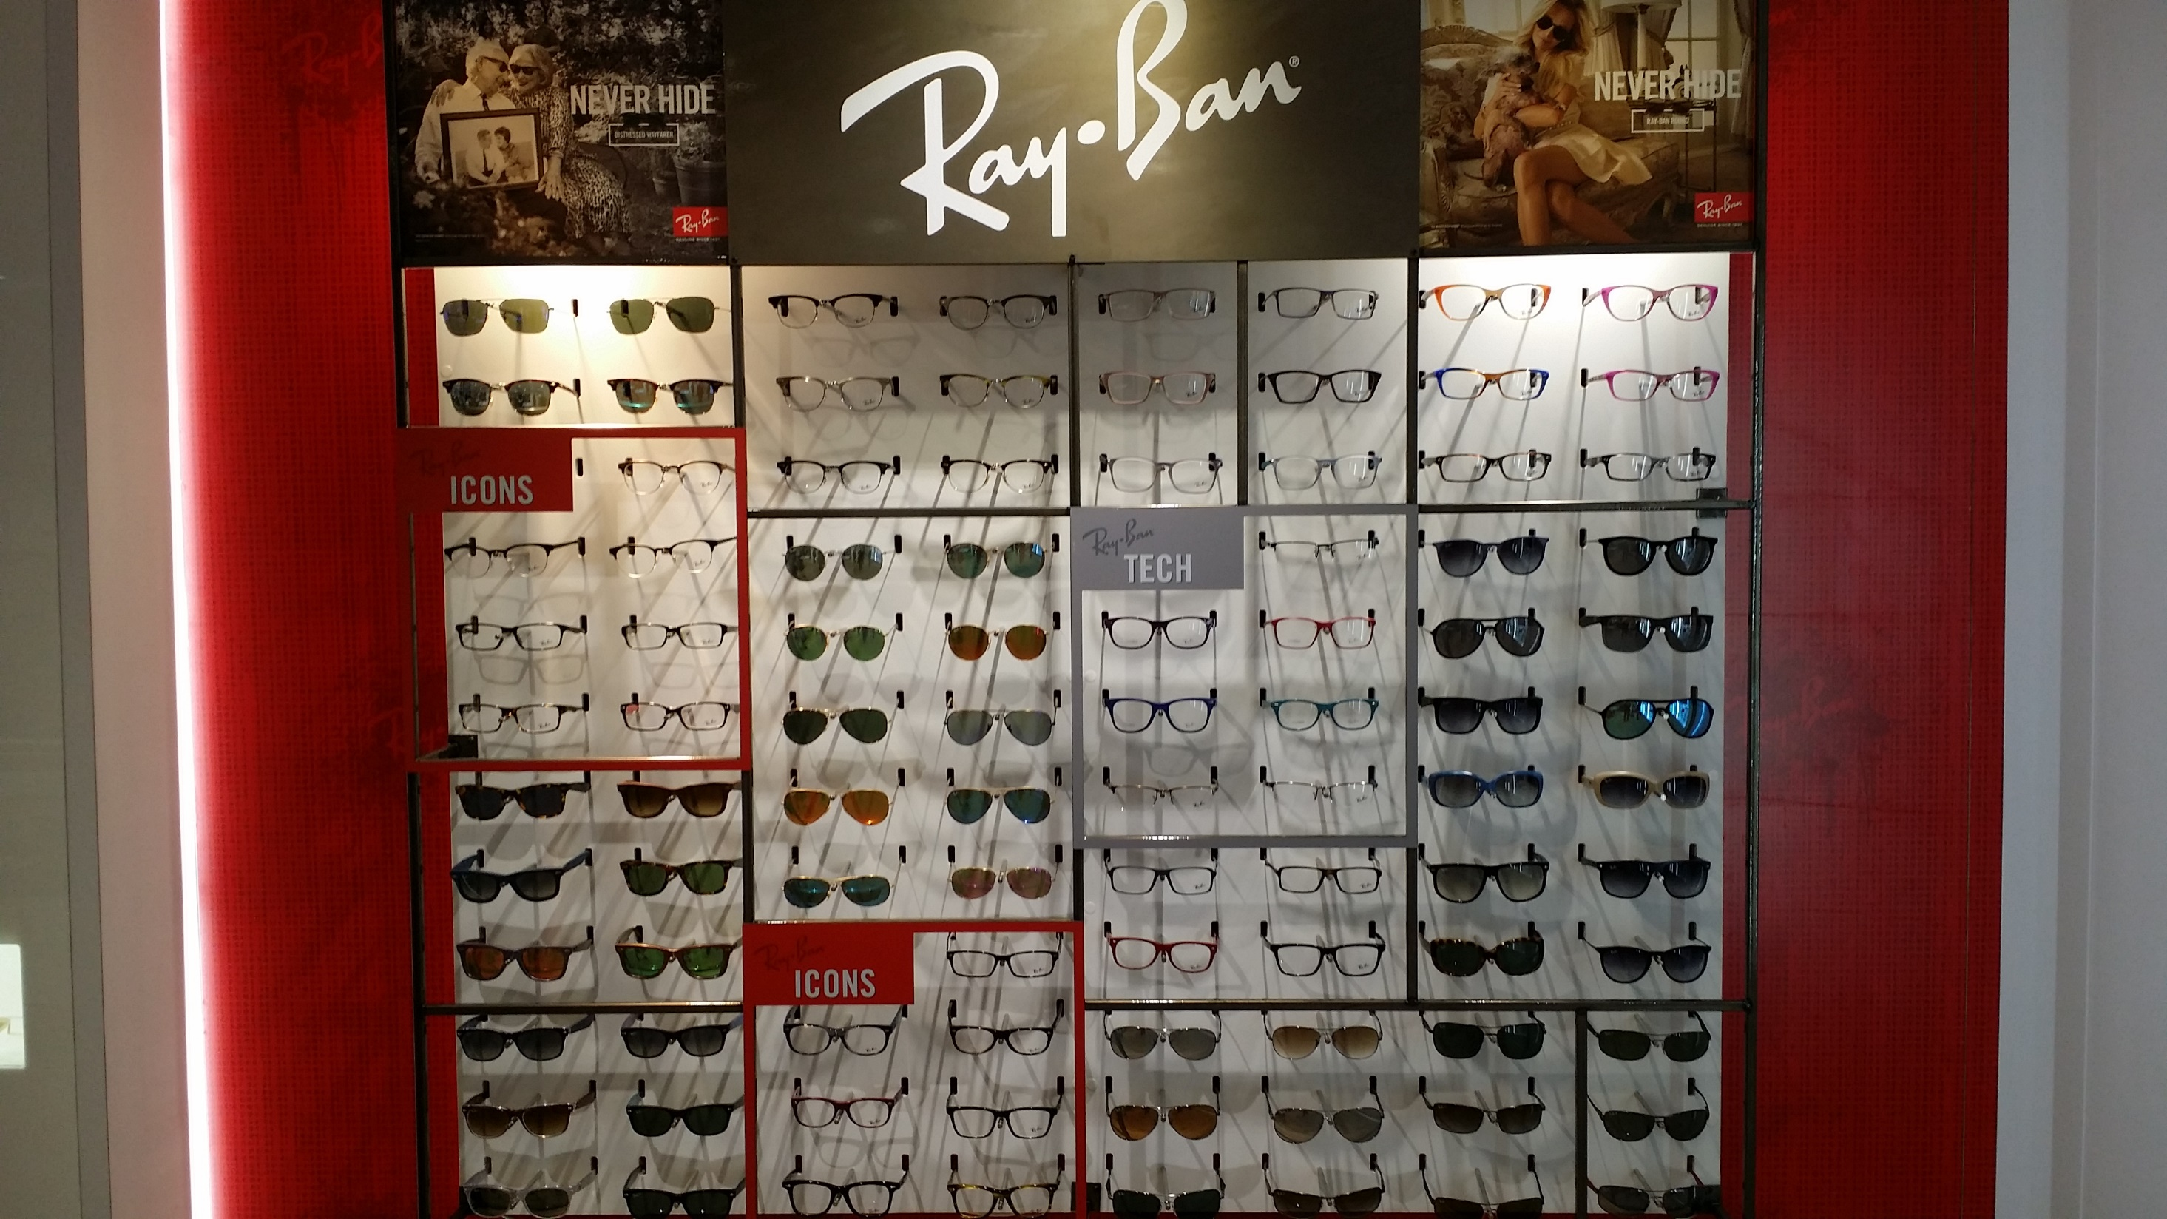

Slide 111
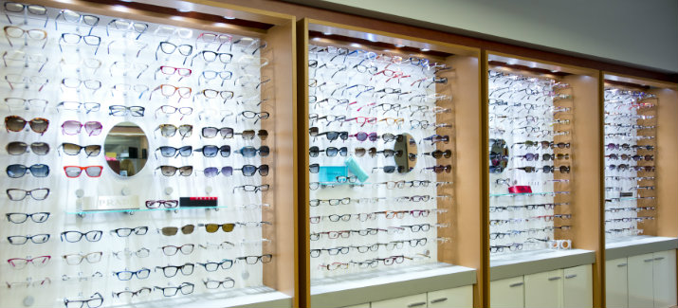
HIDDEN COSTS
What does it cost you to have a Frame on your Frameboard?
$15
Ordering the frame
Unpacking the frame
Checking in the frame
Adjusting the frame
Putting the frame on display
Cleaning the frame

Slide 112
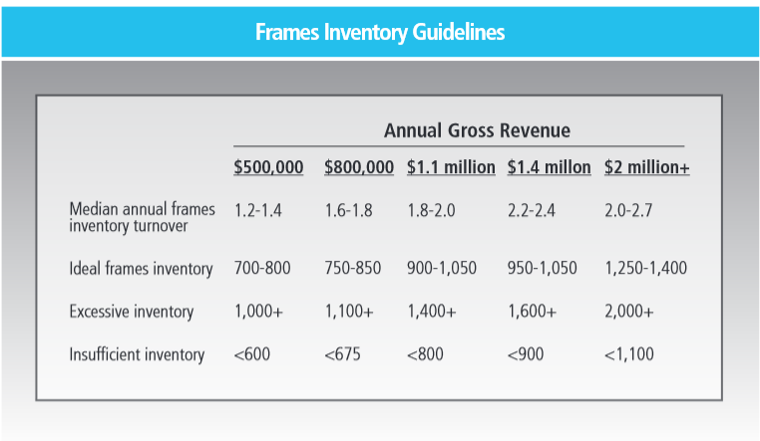

Slide 113
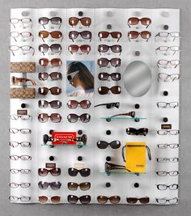
What is the minimum number of frames of any line to display on your frameboard?
14

Slide 114
Adult Frame Distribution
40 – 30 – 30

Slide 115
FRAMEBOARD MANAGEMENT
PRICE POINT | HOW MANY | # SOLD
> $500
$450 - $499
$400 - $449
$350 - $399
$300 - $349
$250 - $299
$200 - $249
$150 - $199
$100 - $149
<$100

Slide 116
Fashion Forward
Contemporary
Conservative
CONSERVATIVE
PRICE POINT | HOW MANY | # SOLD
> $500
$450 - $499
$400 - $449
$350 - $399
$300 - $349
$250 - $299
$200 - $249
$150 - $199
$100 - $149
<$100
MEN’s
WOMEN’s
UNISEX

Slide 117
MEN - CONSERVATIVE
PRICE POINT | HOW MANY | # SOLD
> $500
$450 - $499
$400 - $449
$350 - $399
$300 - $349
$250 - $299
$200 - $249
$150 - $199
$100 - $149
<$100
MEN - CONTEMPORARY
PRICE POINT | HOW MANY | # SOLD
> $500
$450 - $499
$400 - $449
$350 - $399
$300 - $349
$250 - $299
$200 - $249
$150 - $199
$100 - $149
<$100
MEN – FASHION FORWARD
PRICE POINT | HOW MANY | # SOLD
> $500
$450 - $499
$400 - $449
$350 - $399
$300 - $349
$250 - $299
$200 - $249
$150 - $199
$100 - $149
<$100

Slide 118
Managing COGS
Manage purchases
  Utilize prompt pay discount
  Buy in bulk
  Consolidate vendors
Manage utilization
  Manage remakes
  Manage inventory
  Manage shipping & handling fees
  Manage shrinkage

Slide 119
Staff Payroll
15-20% of Gross Collections, Median = 20%
The entire cost of your non-lab staff
  But no doctor wages, bonuses, and benefits
Include wages, bonuses, benefits and don’t forget payroll taxes, uniforms, profit sharing, retirement plans … everything it costs you to have your staff
Notes:
119

Slide 120
Full Time Equivalent
Total # of hours worked
Ave # of full time hrs
120 hrs worked
40 hrs
= FTE
= 3 FTE

Slide 121

Assign staff responsibility
We know what we want to produce so how do we make it happen?
Notes:
121
121

Slide 122

What is your measurable end product?

Slide 123
Owners/Board
PRODUCT
MEASURE
Set the vision for the practice
Maintain a fiscally healthy practice (Revenue & Expenses Management, Profit centers)
Maintain effective risk management (Insurance, Attorneys, Written system protocols)
Actively engage in practice future planning (3 year Goals min, ACA prep)
Create an effective practice culture
Patient & Staff QC
Practice numbers
ACA prep checklist
Risk management checklist
3 year practice plan

Slide 124
How do you measure loyalty?
The Ultimate Question
Net Promoter Score
On a scale of 0 to 10, how likely are you to refer a family member or a friend to our practice?
0 1 2 3 4 5 6 7 8 9 10
  9 – 10 Promoters
  7 – 8 Neutrals
  0 – 6 Detractors
80% 9 - 10
15% 7 - 8
5% 0 - 6
80
- 05
75 NPS

Slide 125

What did you like best about your eyecare visit today?

Slide 126
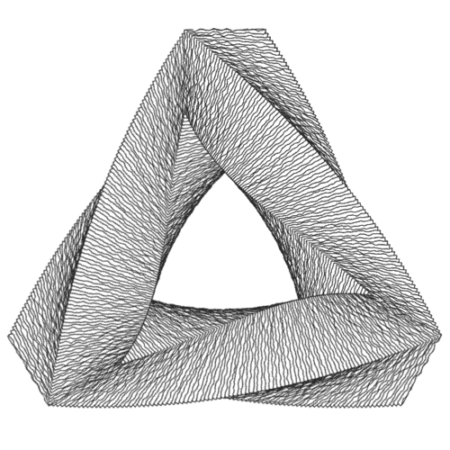
What change would have improved your eyecare visit today?

Slide 127
Optometrist
PRODUCT
MEASURE
Excellent customer service
Complete care prescribed
% Treatment plans completed
Gross revenue (doctor efficiency ~ $700K/FTE OD to be average)
Patient QC
Staff QC
Complete care
Capture rate
$/FTE OD

Slide 128
Practice manager
PRODUCT
MEASURE
Excellent customer service
Fiscally healthy practice (Transparent management, profit centers approach)
Well-trained productive staff
Improved systems (efficiency & effectiveness)
Improving practice culture
Reporting to CEO/Board (When, what?)
Patient QC
Staff QC
Revenue
Expenses
# patients seen
# new patients
Capture rates

Slide 129
Optical Lab Manager
PRODUCT
MEASURE
Excellent customer service (Jobs delivered to patients when promised)
Complete care
Fiscally healthy optical (Transparent management, profit centers approach)
Well-trained productive staff
Optical is prepared to see patients
Improved systems (efficiency & effectiveness)
Patient QC
Revenue
Capture rate

Slide 130
Dispensing Optician
PRODUCT
MEASURE
Excellent customer service
Complete care
Dispensed materials
Accurate fees
Insurance filed day of exam
Patient bill paid
Improved systems (efficiency & effectiveness)
Patient QC
# jobs dispensed
$/Optician

Slide 131
Patient Care Coordinator
PRODUCT
MEASURE
Excellent customer service Manager of first impressions (Resolve patient questions)
Efficient & effective patient flow (including Scheduling, phone calls, checkout, insurance
Increasing numbers of patients seen (recall, appointment confirmation)
Prepare the office to see patients
Take payments
Manage daily activities operational checklist
Improved systems (efficiency & effectiveness)
Patient QC
# patients seen
Daily activities completed

Slide 132
Paraoptometric Technician
PRODUCT
MEASURE
Excellent customer service
Efficient patient flow
Identifying for doctor/optician areas needing care
Improved systems (efficiency & effectiveness)
Patient QC
On-time

Slide 133
Contact Lens Technician
PRODUCT
MEASURE
Excellent customer service
CL lenses delivered to patients when promised
Increase CRT fits
Increase in-house CL purchases
Improved systems (efficiency & effectiveness)
Patient QC
# in-house purchases
# annual supplies
CL dispensed

Slide 134
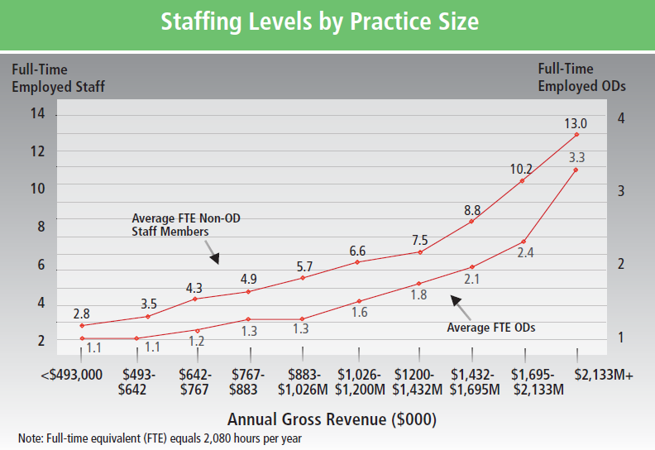

Slide 135
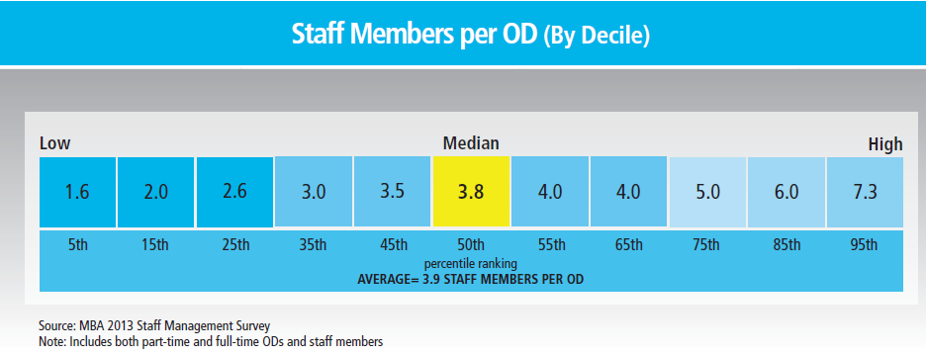

Slide 136
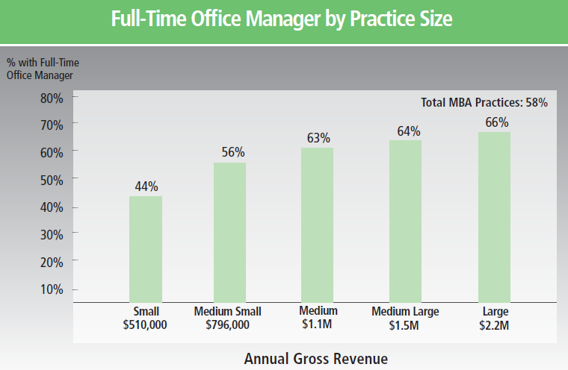

Slide 137
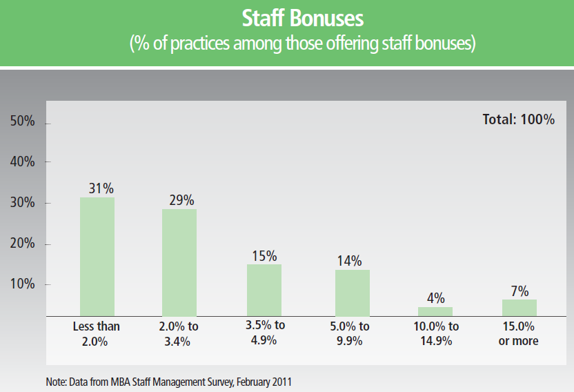

Slide 138
Staff management
Hire managers not workers
Incentivize
  Money
  Time off
  Week-end away
  Support teams
  Gifts
  Recognition

Slide 139
Manage Payroll
Organize the work
  Identify work needed
  Identify positions needed
  Establish position agreements
Manage the work
  Manage overtime
  Delegate frameboards to vendors

Slide 140
Marketing
2-4% of Gross Collections, Median = 2%
Internal marketing
External marketing
Strategy
  Get current patients to return
  Get current patient to refer
  Increase revenue / patient
Tactics
  Get patients to return
    Pre-appoint
  Get referrals
    Referral programs
  Increase revenue / patient
    Packaging
    Bundling
    Preset patients to purchase
Strategy
  Help people to self diagnose and come to you for care
Tactics
  Newsletters
  Civic participation
  Direct mail
  Speaking
  Yellow pages (*phone bill)
  Advertising
  Screenings
  Websites
Notes:
140

Slide 141
Clinical Equipment
2-5% of Gross Collections, Median = 2%
Purchases
Interest on equipment loans
Leases
Service contracts
Repairs and maintenance
(DO NOT charge lab equipment here)
Notes:
141

Slide 142
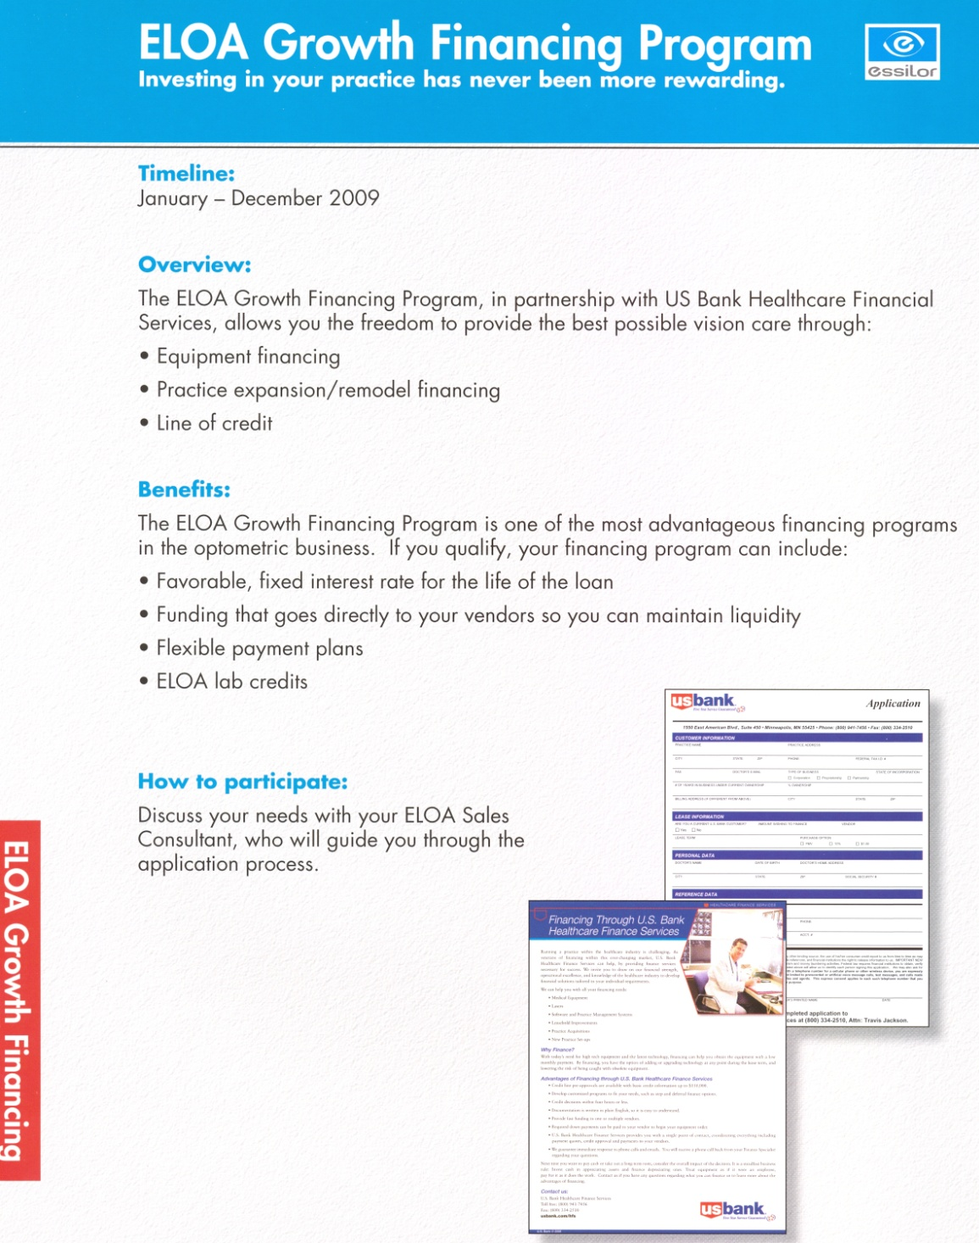

Slide 143
Occupancy costs
4-8% of Gross Collections, Median = 6.5%
Renting
If you own the building
Rent
Utilities
Triple net lease
Maintenance
Janitorial service
Insurance
Property taxes
You should rent it to the practice
Notes:
143

Slide 144
Office square footage
 | Revenue/ ft2 | ft2 | Ave lanes
$2.2M | $500 | 5,000 | 5.6
$1.4M | $424 | 3,509 | 4.1
$1.1M | $362 | 3,000 | 3.3
$790K | $320 | 2,550 | 2.6
$503K | $256 | 1,850 | 2.1
TOTAL | $361 | 3,000 | 3.5

Slide 145
Manage Occupancy
Evaluate space utilization
Go paperless – reclaim the file room
Exam room under 13 ft – use mirror system

Slide 146
Overhead
6-9% of Gross Collections, Median = 6.4%
Accounting
Association dues
Bank charges
Chart supplies
Conferences
Consulting services
Internet
Journal subscriptions
Laundry services
Legal services
Meals and entertainment
Office supplies
Outside services
Taxes
Telephone
Notes:
146

Slide 147
Managing Overhead
Manage purchases
  Create a purchase order system
Manage utilization
  Budget
  Manage office supplies
  Reduce waste

Slide 148
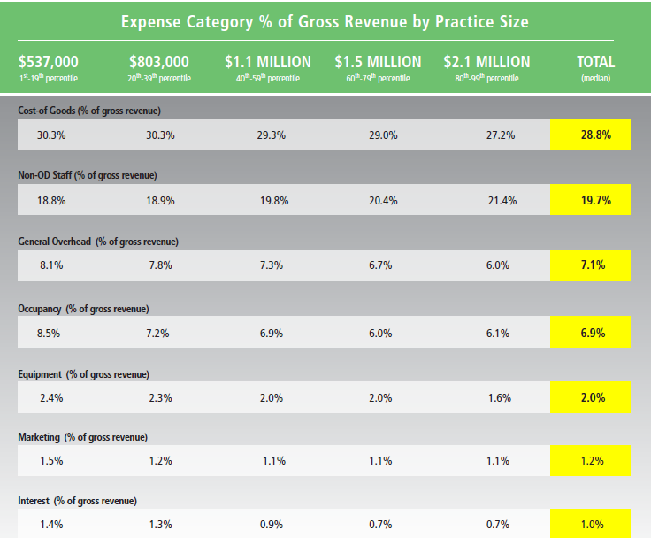

Slide 149
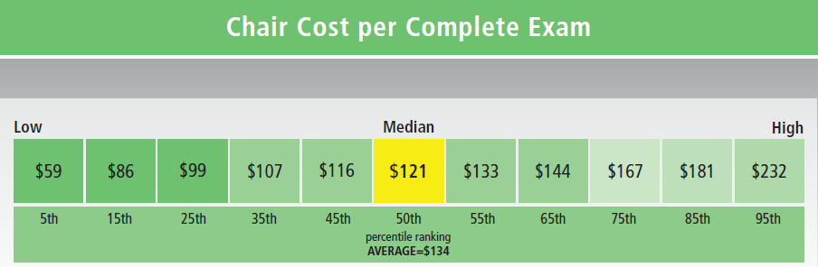
Your could also calculate: Chair cost per Hour

Slide 150
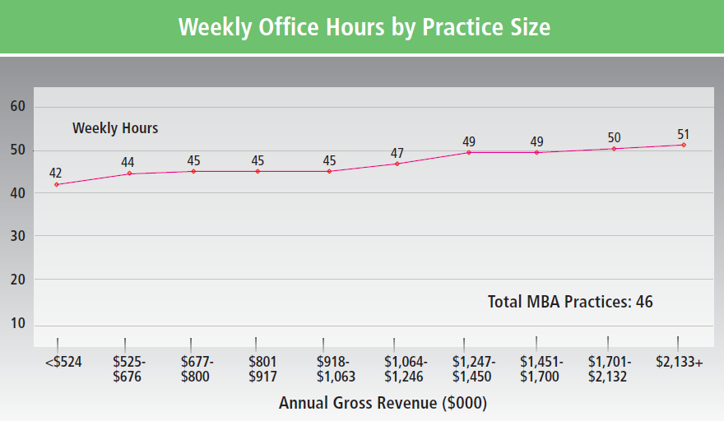

Slide 151
Money IN
Money OUT
Money LEFT OVER

Slide 152
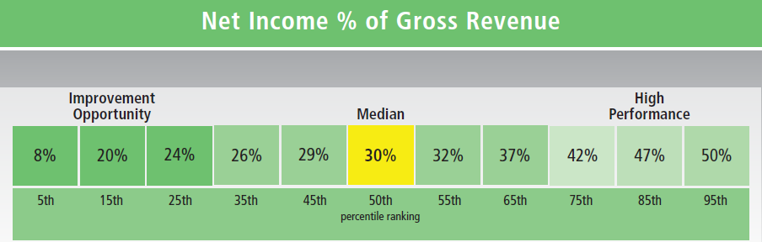

Slide 153


Slide 154
Benchmarks
Net = 40%
50%
Gross revenue $700,000/doc
Net 30 - 40%
Cost of Goods Sold 27 - 33%
Payroll 15 - 20%
Overhead 06 - 09%
Marketing 02 - 04%
Equipment 02 - 05%
Occupancy 04 - 08%

Slide 155
Benchmarks
Net = 40%
60%
Gross revenue $700,000/doc
Net 30 - 40%
Cost of Goods Sold 27 - 33%
Payroll 15 - 20%
Overhead 06 - 09%
Marketing 02 - 04%
Equipment 02 - 05%
Occupancy 04 - 08%

Slide 156
What % of your profits come from
The top 30% of your patients?
  70%
The bottom 30% of your patients?
  3%
Source: Dr. Peter Shaw-McMinn

Slide 157


Slide 158

The product of benchmarking is …
performance improvement

Slide 159
Where can we find
the practice
Financial Numbers?
Notes:
159

Slide 160
P&L
Gross
Expenses
Direct Cashflow
Bank
Net
Balance sheet
Owns
Owes
Equity
Notes:
160

Slide 161
Exams
Comp
Total
Hours worked
FTE
Staff
Doctors
FTE
New
Possible
Practice
Hours open
Hours worked
Notes:
161

Slide 162
Identify key practice numbers you want to track
NON-FINANCIAL NUMBERS
FINANCIAL NUMBERS
Gross collections
COGS
Payroll
Overhead
Marketing
Occupancy
Equipment
Total # of exams
Total # complete exams
Total # of new patients
Total # Dr. hours
Total # staff hours
Total # hours open
FTE Drs. & Staff

Slide 163

“Insanity: doing the same thing over and over again and expecting different results.”
  Albert Einstein
Notes:
163

Slide 164
Systems Insights
All systems within the organization must have as their end result the same goal as the practice
  Every job in the practice must contribute directly or as support to a job that contributes directly to what the practice produces
  How does every job contribute to the end product of the practice?

Slide 165
Systems Insights
Create the organization’s systems, then the positions will identify themselves

Slide 166
Systems needed for …
Preparing the office to see patients
  HR, Supplies & Maintenance, Communications
Enrolling patients for care
  Internal marketing, Scheduling, Central files
Handling practice finances
  Money in, money out, paper trail
Delivering care
  Primary care, Secondary care, Dispensary
Quality Control
  Patient QC, Staff QC, Lab QC
Public Relations
  PR events, Success stories, External marketing
Executive functions
  Legal, Insurance, Planning

Slide 167
Managing Office Meetings
5 minute daily huddle
  Review the schedule for the day
  Triage any problems
1 hour weekly review / practice update
  Each staff member
    What is your level of control of your end product?
    What is your written plan for the coming week?
    How can we as an office help you achieve your end product goals?
  Update or education
1 day every 6 or 12 months brainstorming session
  What are we doing that does not make sense any more
  What could we be doing better

Slide 168

Primary Sources of Money
PAYMENT METHODS
Cash
Check
Credit card
Debit card
Lay-away plan
Pre-dated checks
Pay pal
Essilor’s financing program
Care Credit
Pre-authorized checking
Bartering
Make it easy for the patient to pay

Slide 169


Slide 170
Truth-in-Lending
Is a federal law and is applicable in all jurisdictions
Requires voluminous disclosure and reporting requirements by the practitioner
Applies to practitioners who permit credit and subsequently bill patients for amounts due.

Slide 171
Truth-in-Lending
To fall under the obligations of Truth-in-Lending, an eyecare practice must:
  Apply a finance charge to unpaid accounts
  Or structure payment from patients in more than four installments (not including a down payment)

Slide 172

www.reviewob.com

Slide 173

Page 5 - Eyemed, Davis, VSP

Slide 174

We need to learn to speak in
CONSUMER FRIENDLY LANGUAGE
People want to know COMPARATIVE VALUE – “How much am I saving?”

Slide 175
How to Discuss Vision Plans with Patients
Role play
Script
Advocate
“Maximize your benefits”
“You have a great plan that you can use towards all of our frames”
“No restrictions”
DO NOT sell the lenses first
“We don’t make the glasses – it can take up to 2 weeks”

Slide 176


Slide 177


Slide 178


Slide 179
How to make a profit with managed care vision plans
Knowledge
Pricing
Presentation
Products

Slide 180


Slide 181


Slide 182

Manage your return to the office

Slide 183

Next Steps

Slide 184

You are not alone.
We are here to help!

